Slide 1
Ostomy Care Confidential
Hoe JIJ invloed kan hebben op de peristomale huid
Plaats, datum, 2018
Notes:
Hollister Associate to present the Hollister Education Brand – Hollister Education

Slide 2
Persoonlijke slide
Plaats hier informatie over jouw praktijk/instelling, team en manier van werken
Plaats een afbeelding van de praktijk/instelling

Slide 3
Wat is Ostomy Care Confidential?
Avond door en voor stomaverpleegkundigen
Interactie tussen collega’s
Notes:
The ostomy educational sessions are entitled Ostomy Care Confidential. …. But it really is NOT so confidential. Confidential also means taking someone into your “confidence.”
These ostomy educational events are an opportunity to share information and ideas and to do so with confidence. It also means we should not be secretive about the WOC nurse practice. We need to “spread the word” amongst a group of specialists and help reduce the number of peristomal skin conditions patients experience.
This event is also an educational event that is focused on “peer to peer” education. Learning from each other!

Slide 4
Doelen
Inzichtelijk maken op welke schaal peristomale huidproblemen voorkomen
Identificeren van alle factoren binnen het gehele zorgpad die invloed hebben op gezondheid van de peristomale huid
Bespreken van strategieën die de conditie van de peristomale huid verbeteren
Notes:
The first program focused on being proactive to minimize peristomal skin complications by obtaining the correct FIT with ostomy products and using the right barrier FORMULATION to help maintain healthy peristomal skin.
The OCC educational events have continued to focus on peristomal skin issues as it continues to be an issue that needs to be addressed. We know that peristomal skin complications impacts patients quality of life, Clinical Outcomes and overall Health Economics.
The objectives of our meeting today are:
Review the magnitude of PSC – We will provide you with some data that WOC nurses provided in the first two OCC events as well as some literature documentation
Identify factors along the continuum of care that impact peristomal skin health
Identify and discuss strategies to improve peristomal skin health in your practice
How do we get a plan for making change in a specific care setting
How do we do it? Are there tools available to use?
Change is happening all around us – How can we change our practice?

Slide 5
Interactie tussen collega’s
Notes:
The educational event is not solely a lecture format. It includes audience participation with all of those in attendance. It is your clinical experience and stories that will help each and everyone of us learn.
Sharing with our colleagues will make this session most valuable.
Each of you will receive a Turning Point Audience Response Card. We are going to ask questions throughout the evening that you can answer. This is usually followed by some great discussion and learning. We will have a TEST question to familiarize yourself with using the ARC and then you will see questions throughout the presentation!

Slide 6
Wat is je favoriete kleur?
Oefenvraag
Rood
Blauw
Oranje
Geel
Notes:
This is a test question to ensure everyone understands how to use the Audience Response Cards.
Reminders:
Please push the response button firmly
You can push your response numerous times as it will only be recorded once
This is anonymous – no one will know your response

Slide 7
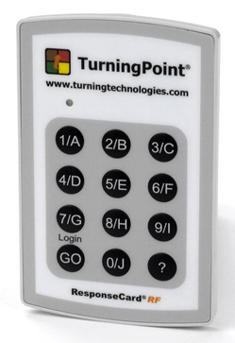
Mijn deelname aan de enquête blijft anoniem en ik ga akkoord dat mijn antwoorden door Hollister gebruikt kunnen worden in toekomstige publicaties.
Ja
Nee
Notes:
This question is being asked in case Hollister or the speakers want to use this data as a “snap shot” in time and perhaps use it in a publication or a presentation.
If you do not agree – we will want you to participate in all conversation but would ask that you identify yourself and hand back the audience response card.

Slide 8
Heb je eerder een Ostomy Care Confidential evenement bijgewoond?
Vraag 1
Ja
Nee
Notes:
Although each of the OCC events build upon each other – it is not necessary that you have already attended the previous educational events. This evening will involve great discussion and allow you to take home an action item.

Slide 9
Hoeveel jaar ervaring heb je als stomaverpleegkundige?
Vraag 2
Minder dan 5
5-10 jaar
11-15 jaar
> 15 jaar
Notes:
This question will allow the speaker to understand the clinical experience in the room. It is important to emphasize that the OCC event involves a great deal of dialogue between the WOC/ET nurses – regardless of the years of experience a clinician has had – we can all learn from each other!

Slide 10
Waar besteed je de meeste uren aan stomazorg?
Vraag 3
Afdeling van het ziekenhuis
Thuiszorg
Verpleeghuis/revalidatie
Polikliniek van het ziekenhuis
Onderwijs
Anders
Notes:
FYI: The statistics at the OCC events are very similar to the distribution of WOC nurses that are members of the WOCN Society. These are the responses from 2015

Slide 11
Hoeveel procent van jouw werktijd besteed je aan stomazorg?
Vraag 4
Tot 10%
11-25%
26-50%
51-75%
76-100%
Notes:
Possible follow-up questions:
Want to understand the division of time spent on ostomy care v. other activities the WOC/ET nurse does.
Are they being pulled more into wound care? Are they doing more administrative work?
Do they involve staff in routine ostomy care?
Has this changed over time?

Slide 12
Ostomy Care Confidential
De omvang van het probleem

Slide 13
Welk percentage van stomadragers in jouw praktijk ontwikkelt peristomale huidproblemen?
Vraag 5
0-25%
26-50%
51-75%
76-100%
Notes:
This is a question that was asked two years ago in OCC 2014.
We are asking this question in 2016 and will look at how it relates to the responses in 2014.

Slide 14
Bewustwording – Noord-Amerika
2014: Ostomy Care Confidential
Welk percentage van stomadragers in jouw praktijk ontwikkelt peristomale huidproblemen?
Notes:
This was a question that was posed to your WOC / ET Nurse colleagues at the 2014 OCC educational events in North America. When asked how many of their patients developed a peristomal skin problem over the lifetime of having an ostomy – the response is astounding. If you look at the data – more than half of the WOC nurses feel that up to 50% of their patients will experience a peristomal skin problem throughout their lifetime.
Possible follow up questions:
Would you agree with this information?
Do you think it is higher or lower?
Do we actually understand what really happens what the patient leaves our care from the acute care setting?
Do we think no news is good news? Is it?

Slide 15
Bewustwording – UK, ANZ
2014: Ostomy Care Confidential
Welk percentage van stomadragers in jouw praktijk ontwikkelt peristomale huidproblemen?
Notes:
This was a question that was also posed to your WOC / ET Nurse colleagues at a 2014 OCC educational event in UK an ANZ. . When asked how many of their patients developed a peristomal skin problem over the lifetime of having an ostomy – the response is astounding. If you look at the data – more than half of the WOC nurses feel that up to 50% of their patients will experience a peristomal skin problem throughout their lifetime. This is VERY consistent with the NA data – this is a global issue!!!!

Slide 16
Vragenlijst stomadrager*
Ingevuld door meer dan 200 mensen
92% heeft wel eens last van lekkage gehad
84% heeft last gehad van peristomale huidirritatie
66% wil graag meer informatie over waarom lekkage optreedt en waardoor huidirritatie ontstaat
*Hollister Incorporated Secure StartTM Onderzoek Q2 2015
Notes:
Secure Start survey 2015 – Refer to Newsletter: Attached
Hollister asked patients to complete an online survey to identify specific areas where the patient felt or a family member is lacking information or support related to living with an ostomy. Over 200 people completed the questionnaire and provided Hollister with invaluable data.
Skin Health
• 92% have experienced some degree of skin barrier leakage and 66% would like information on why leakage can occur : WHAT DOES THIS TELL YOU?
• 84% have experienced peristomal skin irritation and 66% would like information as to why skin irritation can occur: WHAT DOES THIS TELL YOU?
Possible follow up questions:
Obviously peristomal skin problems are an issue and people are experiencing these issues often because of leakage. People want more information on why it occurs and most likely would like to understand how to fix it. Why are these numbers so high?
As WOC nurses we should take this information very seriously. There is a problem and WE are the ones who can take action and help minimize the issue.

Slide 17
Literatuur
Bron | Datum | Bevindingen
Herlufsen et al “Ostomy Skin Study: a study of peristomal skin disorders in patients with permanent stomas.” British Journal of Nursing | 2006 | 57% peristomale huidproblemen
Richbourg et al “Difficulties experienced by the Ostomate after hospital discharge.” Journal of Wound, Ostomy and Continence Nursing | 2007 | 74% peristomale huidirritatie
Nybaek et al “Skin problems in ostomy surgery: a case control study of risk.” Acto Dermato-Venerologica | 2009 | 45% peristomale huidproblemen
Notes:
The literature shares statistics that support the survey findings . Here are a few articles that identify peristomal skin issues and the statistics range from 45% - 74%
You may want to explain two of the articles…a reference list will be provided if the attendees wish to read the article as well.
Key take aways:
Peristomal skin problems continue to be high as reported in the literature.
Patients often do not recognize that they have a peristomal skin problem
Patients often do not seek help even if they recognize they have a problem
Many patients feel peristomal skin issues are “normal”
This is a “Global” issue and not isolated to North America

Slide 18
Ostomy Care Confidential
Health utility
Notes:
definitie health utility: meetinstrument dat de grootte van een gezondheidsprobleem in de beleving van de patient uitdrukt op kwantitatieve manier.
So we probably all agree that there is a problem with the number of patients having peristomal skin problems. And we all agree that when a patient has a peristomal skin problem it impacts the following::
Clinical Outcomes: When a patient's peristomal skin is red and weeping the barrier and pouch may not adhere as well. If they have continued leakage, further skin breakdown and odor
Impact on living life: If the pouch falls off , the patient will not be confident to participate in activities, may socially isolate themselves and not live life as they would have done if they had confidence in their system
Economic Impact: If the pouch requires changing daily - the patient will go through more supplies more often and this will have an impact on the amount of money spent. They may also seek more assistance with the WOC nurse and may end up being admitted to the hospital or visit a ED.
We would like to share another measurement that will help support why peristomal skin problems are BIG PROBLEMS. This measurement is called HEALTH UTILITY!

Slide 19
Health utility
Definitie: Health utility is een kwantitatieve uitdrukking van een gezondheidswaarde.
Vragenlijsten worden gebruikt om fysieke, sociale, cognitieve functie, psychologisch welzijn, en symptomen zoals pijn te meten. (definitie uit notes aangehouden)
De antwoorden van individuele personen op een enquête of vragenlijst worden kwantitatief uitgedrukt. Alles bij elkaar levert dit een samenvattende score op:
“0” = slechtste gezondheidstoestand denkbaar
“1” = beste gezondheidstoestand denkbaar
Notes:
Health Utility is defined as preferences that individuals have for their health state and health outcomes. This is measured by understanding their physical, social, cognitive function, psychological well being and symptoms such as pain.
In the analysis of health outcomes, a number between 0 and 1 is assigned to a state of health or a health outcome They range from 0 = Being the worse health state possible / imaginable – perhaps even death and 1= the best health state imaginable or optimal health. Each health state in between 0 and 1 is assigned a numerical value which represents the preference or utility weight. If some one experiences an improvement in their well being, we say that his or her’s utility has increased. If their well being should decline, we would say that their health utility has decreased.

Slide 20
Health utility
.754
.754
Persoon zonder stoma
Persoon met stoma en gezonde
peristomale huid
Algemene populatie stomadragers; colo, ileo, uro , SF6d 0.701, n=1,938
Hollister data in dossiers
Notes:
The average adult in the U.S. has a reported health utility score of 0.754. Interestingly, this is identical to the average health utility score of an adult living with a stoma (aged greater than 18 and without any skin complications). This would suggest that over time, most people with ostomies have adjusted to their stoma. Of course, a 16year old female waking up to a stoma will have much lower reported health utility than say a 75 year old who has had their stoma for the last 30 years. But in time, we adjust to our new normal.
As a baseline.. We know that the average adult with an uncomplicated ostomy has a health utility of .754 out of 1. The lower the score, the greater the decrease in QOL (including social isolation / socializing with family and friends / etc).

Slide 21
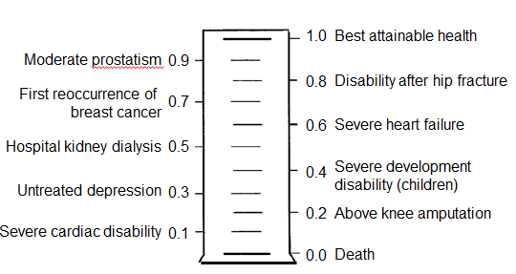
Invloed van peristomale huidproblemen op health utility en kwaliteit van leven
Stoma zonder complicaties 0.754¹
Milde PHC 0.697
Gemiddelde PHC 0.647
Ernstige PHC 0.589
Best haalbare gezondheid
Gematigde prostaatklachten
Beperking na heupfractuur
Eerste herhaling van borstkanker
Ernstig hartfalen
Ziekenhuis nierdialyse
Ernstige ontwikkelingsstoornis (kinderen)
Onbehandelde depressive
Bovenbeenamputatie
Ernstige hartstoornis
Dood
UTILOMETER²
Source: 1. Nichols, T.R. (2013) Pouching System Impact Assessment, Hollister Incorporated (data on file)
2. Bell CM et al. Med Decision Making 2001;21:288-94
Notes:
Now look what happens when a patient has a peristomal skin complication. The health utility decreases … meaning that QOL is impacted. In fact, based on an analysis by Bell in 2001, looking at a variety of health states and summarizing the literature and studies, you can see that someone with a severe PSC may report out their health utility as being somewhere between someone on dialysis and someone with severe heart failure. Even a mild complication has negative effects on quality of life. The lower the score, the greater the negative impact on quality of life.
PSCs decreases well being (or utility). The more severe of the skin complication, the greater the decrease.
As a WOC nurse we want to help patients live a rewarding and dignified life with an ostomy. If they experience a peristomal skin complication – their QOL is impacted.
It is our specialty! We need to manage this issue! Optimal stoma management recognizes the profound impact a skin complication may have on someone’s quality of life.
REFERENCE: Medical Decision Making Article

Slide 22
Betrokkenheid stomaverpleegkundige
Als WIJ het niet doen, wie dan wel?
Als we het NU niet doen, wanneer dan wel?
* Michigan Governor George Romney
Notes:
We want this to be more than just a dinner educational event… we want this to be an educational opportunity where you are inspired to take action to make change in your practice and a difference to your patients.
No one else will take this issue as seriously as a WOC nurse.
IF NOT US…. WHO
IF NOT NOW…..WHEN

Slide 23
Hoe raak jij betrokken?
Notes:
We are handing out a commitment card to you so that as you go through the presentation today you may think of one small change you can make in your practice – write it down!!
Did you know that:
25 percent of people abandon their New Year’s resolutions after one week.
60 percent of people abandon them within six months.
Don’t let your change statement – not come to life!
Dr. Gail Matthews, a psychology professor at Dominican University in California, did a study on goal-setting. She found that you are 33 percent more likely to achieve your goals just by writing them down.
http://www.dominican.edu/dominicannews/dominican-research-cited-in-forbes-article
For this reason we want you to take this card – write down the change you can make to promote better outcomes for your patient by maintaining positive peristomal skin health. Write it down… and post it in your office! ☺

Slide 24
Ostomy Care Confidential
Hiaten:
Het zorgpad
Notes:
Today’s presentation is going to look at the continuum of care and identify “gaps” along the continuum of care that can have impact peristomal skin health.

Slide 25
Het zorgpad
Preoperatief
Ziekenhuis
Na ontslag
Leven met een stoma
Notes:
The continuum of care includes the preoperative period, the time spent in the acute care setting/hospital, the discharge which may be to home or to a rehab center and then living with an ostomy!
Pre-Operative : Stoma Site Marking
Hospital: Short length of stay / Immediate post operative abdomen and stoma
Post Discharge: Changes to the abdomen and stoma / Home care
Living with an Ostomy: Life with an ostomy
There has been a lot of changes in health care – I am sure everyone would acknowledge this.
What has changed in your practice?
Shorter hospital stays
Obesity
Surgical technique
Stoma clinics
Staffing
Insurance / reimbursement
We are going to look at PSCs along the continuum of care. We will identify the gaps and determine where we can make an impact. We will do this through discussion and learning from each other.
Again… remember as we go through this… think where can you make a difference. It does not need to be a big change like a change in policy it just needs to be any change for positive outcomes .

Slide 26
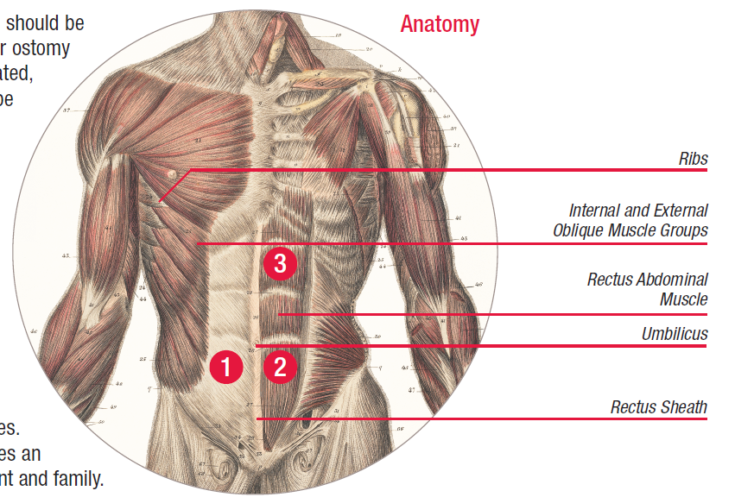
Plaatsbepaling
Anatomie
Ribben
Schuine buikspieren
Rechte buikspier
Navel
Rectale schede
Preoperatief
Colwell JC, Gray M. Does Preoperative Teaching and Stoma Site Marking Affect
Surgical Outcomes in Patients Undergoing Ostomy Surgery? JWOCN, Sept/Oct 2007.
Wound, Ostomy and Continence Nurses Society. (2014). WOCN Society and AUA Position Statement on Preoperative Stoma Site Marking for Patients Undergoing Urostomy Surgery. Mt. Laurel: NJ. Salvadalena, G. et al. Public Library : 2015 May/June JWOCN.
Notes:
The preoperative period is very important – especially for pre-operative marking. Multiple studies indicate that patients who have their stoma site marked preoperatively by a trained clinician have fewer ostomy-related complications. An appropriate stoma site may decrease ostomy-related complications such as leakage of the pouching system and peristomal dermatitis.
Colwell JC, Gray M. Does Preoperative Teaching and Stoma Site Marking Affect
Surgical Outcomes in Patients Undergoing Ostomy Surgery? JWOCN, Sept/Oct 2007.
May reduce the incidence of postoperative stoma and peristomal complications
ASCRS and WOCN Joint Position Statement on the Value of Preoperative Stoma Marking
for Patients Undergoing Fecal Ostomy Surgery, JWOCN, May/June 2015
Poor stoma placement can cause undue hardship and have a negative impact on psychological and emotional health. At its worst, poor stoma placement or construction can be disabling for the patient and his or her family, leads to direct dissatisfaction with the diversion choice and greatly impairs quality of life for the patient and caregiver. Proper placement of the stoma enhances patient independence in stoma care and resumption of normal activity
May help reduce post-operative problems such as leakage, fitting challenges, need for expensive customized pouches, skin irritation and pain.

Slide 27
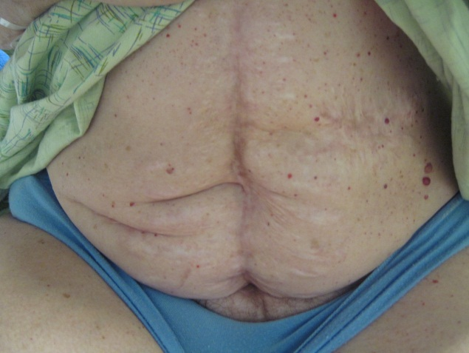
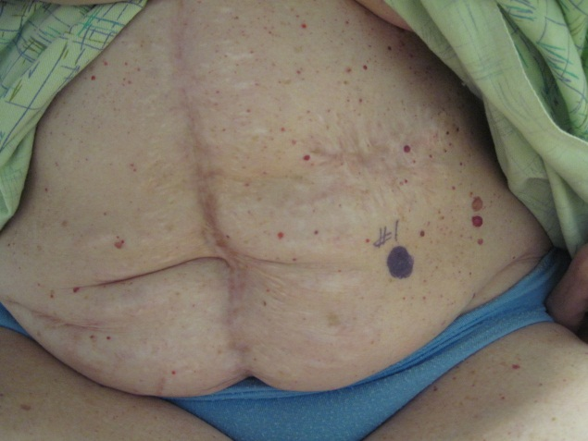
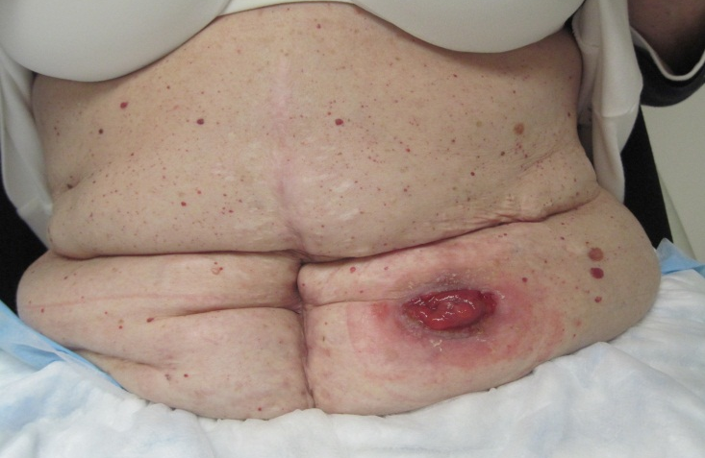
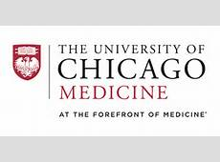
Het markeren van de stomalocatie
Met dank aan:
Notes:
Here is an example of stoma site marking and its importance. Look how different the abdomen looks! Some considerations are old scars, waist line etc.
Poor stoma placement with this woman would have led to devastating consequences with leakage, peristomal skin issues, decreased QOL, poor acceptance of stoma etc!
It seems the longer we are WOC nurses, the more importance is placed on stoma site marking. It takes huge responsibility and makes such a difference!

Slide 28
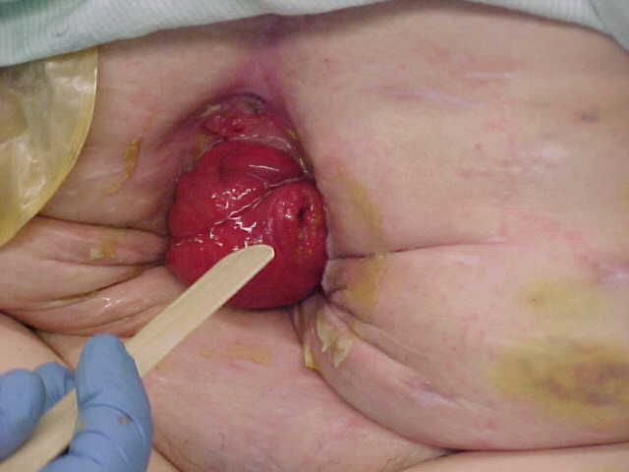
Het markeren van de stomalocatie Casus
Notes:
This is an example case study
These photos are examples. Please replace with your own photos and your own story!

Slide 29
Het markeren van de stomalocatie Casus
Notes:
This is an example case study.
Patient has MS
Ileostomy – well spudded
Convexity
Leakage occurring especially when patient is sitting in wheelchair
These photos are examples. Please replace with your own photos and your own story!

Slide 30
Bewustwording – Noord Amerika
2014: Ostomy Care Confidential
Welke percentage van de geplande operatiepatiënten worden preoperatief gemarkeerd?
Notes:
This is very interesting. Of the 704 WOC nurses reported that their patients were marked <50% of the time
Did you know that in Australia when this question was asked, 39% of stoma care nurses responded that ALL their patients are marked preoperatively compared to the US 12%.
Did you know that in the UK 100% of all planned surgery are marked? This has become a standard of care with processes in place for per-op care. Just what is the UK doing to make such an impact on this area along the continuum.? (This information provided by stoma care nurse in UK
Possible further discussion
How are we missing people for teaching and marking?
Is this acceptable?
What do you think the barriers are?
Why are patients not getting marked?
Are surgeons marking?

Slide 31
Bewustwording – North America
2015: Ostomy Care Confidential
Denk je dat iemand anders dan een stomaverpleegkundige de patiënt peoperatief kan markeren voor een stomaoperatie?
Notes:
Here is a fact from 2015 OCC. What are your thoughts on this?
Is this an area where you think can make change in your own practice? What kind of things can you do?
What happens on weekends when a WOC nurse is not available?
Can you educate surgeons / residents / nurses to do stoma site marking?
Do you feel this takes away from the WOC nurse importance and responsibility?

Slide 32
Heb je een aangewezen vervanger binnen jouw praktijk om stomalocaties te markeren als je niet aanwezig bent? Buiten je directe collega-stomaverpleegkundigen.
Vraag 6
Ja
Nee
Notes:
Possible Follow Up Questions:
If no why?
If yes… how did you initiate this?
Does anyone have examples?

Slide 33
Wanneer patiënten preoperatieve voorlichting krijgen, hoeveel procent van de informatie/voorlichting onthouden zij volgens jou?
Vraag 7
0-25%
26-50%
51-75%
76-100%
Notes:
Follow up Questions:
Do you priorize what you teach? What is that?
How can we be creative n our teaching?
Do you have any examples to share?

Slide 34
De impact op patiënten Casus plaatsbepaling
Met betrekking tot plaatsbepaling: Heb je een casus, die jouw werkwijze en/of die van collega’s veranderd heeft?
Heeft iemand tips die hij/zij wilt delen?
Notes:
Stoma site marking makes a difference in helping to minimize PSC post operative. BUT we know it is not just the marking… we know that preoperative teaching makes a difference and we need to advocate that ALL patients see a WOC nurse before surgery – because this is where it begins.
What kind of things can you do to make sure that ALL your patients see a WOC nurse before surgery to receive both stoma site marking and preoperative teaching? If you can think of something – write it down!
Possible follow up discussion:
Preoperative KITs
Ostomy Preoperative Clinic
Collaborate with preoperative assessment clinic
Stoma site marking techniques
Designate stoma site marker
Educating surgeon / residents
Pouch change preoperative / Practice with closure
Fake stoma application preoperative
EXAMPLE: Jan Colwell at the university of Chicago has developed preoperative videos that are on youtube to assist with teaching both pre-operatively and postoperaatively
NOTE: Try to keep the discussion to skin and PSCs.

Slide 35
Jouw inzet
Notes:
Can you make a commitment to make a change in the preoperative period that would impact peristomal skin health?
If so… write it down!

Slide 36
Het zorgpad
Preoperatief
Ziekenhuis
Notes:
The patient has now had surgery and is in the hospital recovering and preparing for discharge. This is probably the most overwhelming stage for the patient but the most important stage to prepare them to be discharge and set them up for success and avoid peristomal skin complications. Unfortunately for WOC nurses it is one of the more challenges stages along the continuum as most WOC nurses are in acute care setting and this is where the expertise is located.
Did you know that of all the nurses that attended the 2015 OCC – 71% were from the acute care setting and this is reflective of the national WOCN statistics. So who is helping the patient once they have been discharged.
What are the MOST challenging issues that you are facing in the acute care setting that impact peristomal skin health?
Possible follow up discussion:
Length of stay
Lack of bedside nurse knowledge
Focused doing more wound care and less ostomy
Not working weekend and patients discharged on weekend
No time for family interaction
Patient over medicated / pain / diagnosis
Information overload

Slide 37
Wat is de gemiddelde verblijfsduur na het aanleggen van een darmstoma?
Vraag 8
1-3 dagen
3-5 dagen
5-7 dagen
>7 dagen
Notes:
This question is specifically about fecal ostomies… We will also ask the same question for a urinary ostomy.
Possible Follow Up Questions:
How does this impact your teaching to help minimize peristomal skin complications?
How much has this changed over time?

Slide 38
Wat is de gemiddelde verblijfsduur voor het aanleggen van een urostoma?
Vraag 9
1-3 dagen
3-5 dagen
5-7 dagen
>7 dagen
Notes:
This question is about a urinary stoma…
Does it matter whether it is fecal or urinary?
Is short length of stay an issue overall for both types of ostomies?
Possible Follow Up Questions:
How does this impact your teaching to help minimize peristomal skin complications?
How much has this changed over time?

Slide 39
Ziekenhuisverblijf
Post-operatieve veranderingen van stoma en buik
Beperkte leer- en oefenmogelijkheden
Notes:
The short hospital stay impacts our ability to teach. There is the physical ability to learn but then there is also the emotional/psychological and readiness to learn. This is all impacted in the immediate acute care period.
The ostomy is not yet active. Unable to teach emptying. Does the patient go home and allow their pouch to overfill and have leakage problems?
The stoma is edematous and the abdomen firm and distended. Is the product chosen in the hospital the most appropriate FIT for when the stoma and abdomen change shape once discharged.
Minimal physical activity: The patient may be achieving a good FIT in hospital when there is little stress placed on the pouching system, but this will change when the patient becomes more active and the abdomen changes shape with movement. Is the product chosen the right one a week later? How proactive are you being?
What is critical for the patient to learn before they go home? Do you teach more than emptying?

Slide 40
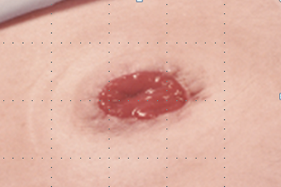
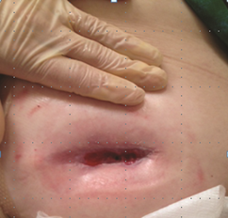
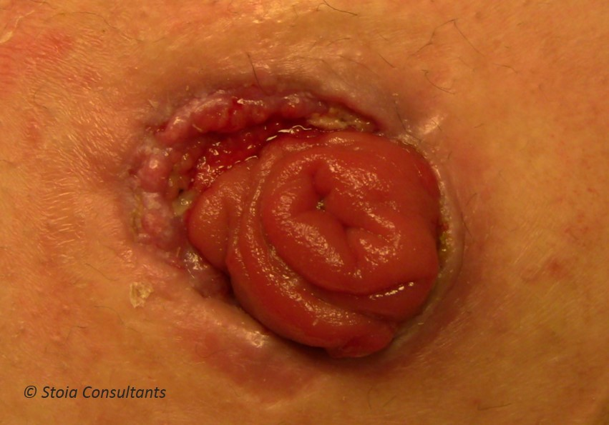
Overige problemen
Onderstaande kan ook leiden tot peristomale huidproblemen
Vlak stoma
Teruggetrokken stoma
Richting van de stoma (links, rechts, boven, onder)
Mucocutane afscheiding
Notes:
Many issues around the stoma (construction, peristomal skin etc) can plays an impact on peristomal skin health.
Stomas that are created flush, retracted or perhaps have a mucocutaneous separation may lead to peristomal skin complications.
Although as WOC nurses we are not able to perform surgery and create “ideal” stomas and sometimes surgeons try their best to create an ideal stoma – this is not always the case!
What are you doing in your practice to help ensure the stoma is constructed ideally
Teach surgeons to stoma site mark
Teach surgeons about the importance of stoma construction
Teach surgeons the impact that poor stoma construction and stoma location can have on peristomal skin health

Slide 41
Welk percentage van de informatie/voorlichting, die jouw patiënt in het ziekenhuis krijgt, wordt er gemiddeld onthouden?
Vraag 10
0-25%
26-50%
51-75%
76-100%
Notes:
Follow up Questions:
Do you priorize what you teach? What is that?
How can we be creative in our teaching?
Do you have any examples to share?

Slide 42
Welk aantal voorlichtingen, gegeven in het ziekenhuis door een stomaverpleegkundige, is effectief?
Vraag 11
1-2
3-4
5-6
>7
Notes:
EFFECTIVE would be defined as return demonstration / or recalling two things back what was taught previously.
Follow up Questions:
Do you priorize what you teach? What is that?
How can we be creative in our teaching?
Do you have any examples to share?

Slide 43
Hoeveel van jouw patiënten/mantelzorgers kunnen voor ontslag met vertrouwen de volgende vaardigheden uitvoeren? Kunnen werken met een klem / geïntegreerde sluiting / kraantje Het legen van een stomazakje
Vraag 12
0-25%
26-50%
51-75%
76-100%
Notes:
Possible Follow up questions
What do you do when the ostomy is not yet active?
Do you rely on family?
Do you rely on home care nurses to do teaching?
Do you have the authority to have patient stay another day?

Slide 44
Hoeveel van jouw patiënten/mantelzorgers kunnen voor ontslag met vertrouwen de volgende vaardigheden uitvoeren? Het verwisselen van het stomazakje
Vraag 13
0-25%
26-50%
51-75%
76-100%
Notes:
Possible Follow up questions
What do you do when the patient is not ready to change the pouch but the surgeon is ready to send them home?
Do you rely on family?
Do you rely on home care nurses to do teaching?
Do you have the authority to have patient stay another day?

Slide 45
Welk percentage van jouw patiënten begrijpt goed hoe zij peristomale huidproblemen kunnen voorkomen en herkennen?
Vraag 14
0-25%
26-50%
51-75%
76-100%
Notes:
Is this a priority in teaching with short hospital stays?
How do you priorize your teaching?
Do you think understanding peristomal skin complications is more important than diet, activity and sexuality teaching?

Slide 46
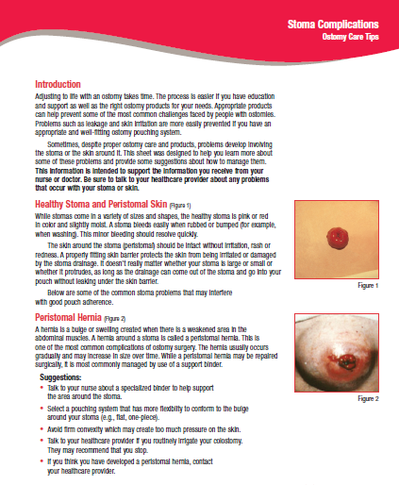
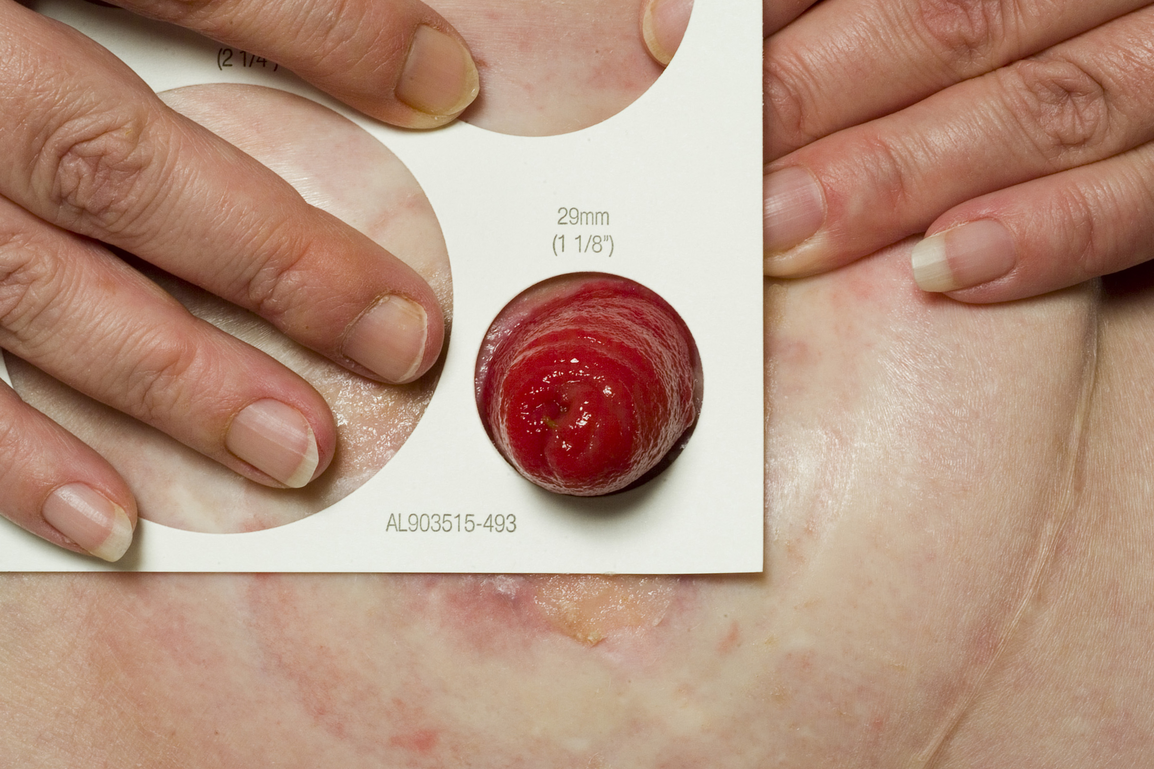
Educatie Peristomale huidproblemen
Onderwijsmateriaal
Mal aanpassen in de periode na de operatie
Bel de stomaverpleegkundige wanneer de peristomale huid er anders uitziet dan de andere kant van de buik
post-op controle afspraak op poli
Notes:
How do you teach your patients about peristomal skin complications?
Remeasure the stoma
Educational materials
Call the WOC / ET nurse when the skin does not look the same as the other side of the body
Routine followup
Discussion Points:
NOTE:
We talk about this today as we know that with early discharge the stoma is still very swollen and within time, the stoma changes size and shape. Does the patient understand this. Do they know how to properly measure and cut their barrier to avoid a peristomal skin problem. Sometimes it can be as simple of changing the barrier size to protect the skin and minimize a peristomal skin complication from occuring.
There has been much discussion around this topic. With new hydrocolloid barrier technology, the barrier should fit so that there is no skin showing. You do not need to worry that the barrier contact with the stoma will cause a laceration as it once did with hard faceplates.
The wording in the new core curriculum book is: “The skin barrier should be blocking access of the stoma effluent to the skin around the stoma. Thus, the opening should fit at the skin –stoma junction”

Slide 47
De impact op patiënten Casus
Kennis doelstellingen
Management doelstellingen
ACKNOWLEDGEMENT:
Toronto Central CCAC – Joanne Greco, Director, Client Services
Toronto Central CCAC – Dipti Purbhoo, Manager, Client Services
Toronto Central CCAC – Raquel Lashley, Care Coordinator
SEHC Metro Toronto – Maureen Cooling, RN, ET
Spectrum Health Care – Holly Murray, RN, BScN, WOCN
University Health Network – Debra Johnson, RN, BScN, ET
University Health Network – Claudia Ganson, RN, BScN, ET
ParaMed Home Health Care – Estrella Mercurio, RN, BScN, ET
Toronto East General Hospital – JoAnne McKeown, RN,BScN, WOCN
St. Michael’s Hospital – Jo Hoeflok, RN, BSN, MA, ET, ACNP, CGN (C)
Sunnybrook Health Science Centre – Debbie Miller, RN, BScN, MN, ET
Ostomy Toronto – Carol Roda
© 2008 Toronto Central CCAC
Reproduced with permission from Jo Hoeflok
Notes:
The Enterostomal Therapy Nurses in the greater downtown area of Toronto recognized the challenges of transitioning new ostomy patients from the acute care setting to the community. Impacted by shortened length of stays (typically 4 days), the ETs noted that the opportunity to provide effective in-hospital patient education was limited, and that the bulk of the education about the new ostomy was happening in the community setting. Equally challenging was the lack of supports for community nurses to provide the enhanced care that this patient population required.
A collaborative working group between acute and community care was established to develop tools that would guide knowledge and skill acquisition for the new ostomy patient. The tool was intended to provide a platform for communication between the patient, the community nurse and the ET about the patient’s journey and progress with their new ostomy. Structured to coincide with planned visits, the tool acknowledged that adaptation was not a single event, but required multiple visits and multiple efforts to reinforce the content.
!

Slide 48
Jouw inzet
Notes:
Can you make a commitment to make a change in the acute care period that would impact peristomal skin health?
What impact can you make???
Possible discussion Topics are:
Assessment
Physical Assessment – Implementing a guide
Product Selection FIT – formulary charts
Education
Discharge Lists
Educational Resources (convexity assessment guide)
Go Pro Video Technology
iPhone Video Technology
Pictures
Transition Programs

Slide 49
Het zorgpad
Preoperatief
Ziekenhuis
Na het ontslag
Notes:
The patient is then discharged home or into a long term care or rehabilitative center. What are the factors that might impact the patient and may cause them to experience a peristomal skin complication?
What are the major issues that patients run into when they are discharged from the acute care setting:
Not enough supplies
No one to call
High Output ostomy / dehydration
Inadequate nursing support

Slide 50
Quotes:
“input jos.”
“input jos.”
“input jos.”
Notes:
We may think that we are being clear in what we say to our patients however there is so much information coming at them and they can only absorb so much. These are actual examples of things people say.
The point of this is that as a WOC nurse in the acute care setting preparing for the patient for discharge ….. We really don’t know how much they recall and what they recall. Can they have a shower? What do I clean my skin with? How do I measure my stoma? How often do I change my barrier? Who do I call if I have a problem? What is a problem? How do I describe my situation?

Slide 51
Met dank aan:
Notes:
Patients deserve teaching by a WOC nurse all along the continuum.
What can we do – what changes can we make to ensure that our patients have the best positive outcome possible.

Slide 52
Bewustingwording – Noord-Amerika
Welk percentage van de nieuwe patiënten ontvangt een thuiszorgverpleegkundige voor een stoma follow-up na het ontslag uit het ziekenhuis?
N=381
Welk percentage van de nieuwe patiënten ontvangt een thuis een stomaverpleegkundige voor een stoma follow-up na het ontslag uit het ziekenhuis?
N=376
Notes:
This is probably not surprising as we have so few WOC nurses in the community. So lots of patients receive a home care nurse or a nurse in a long term care facility but this nurse is not a WOC nurse. What challenges do you face with home care nurses? They are not trained WOC nurses and are masters of many things but not an expert in ostomy management.
Possible follow up discussion:
Do you feel the teaching of home care nurses is at its highest level?
What can we do to support home care nurses?
Do you have any contact with home care nurses? Can you support them?

Slide 53
Heb je contact met de thuiszorgverpleegkundige die jouw patiënten bezoekt?
Vraag 15
Ja
Nee
Notes:
If you do have contact with a home care nurse – what does it look like? Is there strong collaboration? Can we influence them? Can we teach them?
If you do not … how can you make an impact in the home care setting?

Slide 54
Wanneer zou een patient, na ontslag uit het ziekenhuis, een stomaverpleegkundige moet zien?
Vraag 16
Binnen twee weken
Binnen vier weken
Binnen zes weken
Binnen een jaar
Wanneer zich problemen voordoen
Notes:
Possible Follow-up Discussion:
What is your practice like?
Do we have the “manpower” to manage this?

Slide 55
Evaluatie van ondersteunende bronnen voor stomadragers op het web
Hoofdonderzoekers:
Joyce Pittman, PhD, ANP-BC, FNP-BC, CWOCN
Susan Rawl, PhD, RN, FAAN
Doel
Het evalueren van het gebruik van ondersteunende internetbronnen voor stomadragers
Achtergrond
Jaarlijks meer dan 120.000 nieuwe stomadragers in de VS
500,000- 800,000 stomadragers in totaal (2003)
Tot 80% ontwikkelt complicaties gerelateerd aan de stoma.
Kort ziekenhuisverblijf; gefragmenteerde nazorg
Beperkte toegang tot post-operatieve zorg en informatie
Deze beperking kan opgevuld worden door ondersteunende bronnen op internet, waardoor zelfmanagement bevorderd wordt, complicaties geminimaliseerd worden en de aanvaarding van leven met een stoma makkelijker wordt.
Notes:
I would like to share a study done by Indiana Health to evaluate web-based ostomy patient support services. This was a poster presentation at a UK conference and will be an oral and poster presentation done at WOCN/CAET
The principle investigators are Joyce Pitman and Susan Rawl
The purpose of the research was to evaluate the use of web-based patient support resources for patients with an ostomy
Here is just some back ground information
As we have already discussed – there are a great number of patients having ostomy surgery and approximately 80% of them will have complications.
Many of these patients get limited education and follow-up so therefore use web based patient support services to promote self management, minimize complications and enhance adjustment to living with an ostomy.

Slide 56
Belangrijkste bevindingen
Onderwerp | Percentage
Gebruikt het internet als bron van informatie over stoma’s | 48%
Vrienden of familie hebben voor hen gezocht op het internet | 30%
Verwachtte dat ze stoma informatie konden vinden op het internet | 75%
Vond de informatie makkelijk te begrijpen | 82%
Maakte zich zorgen over de kwaliteit van de informatie | 43%
Informatie op zijn/haar favoriete website hielp hen om hun stoma te begrijpen | 85%
Bezocht na de operatie zijn/haar favoriete (stoma)website | 71%
Notes:
These are some of the key findings: NOT all of them but just some I would like to highlight
Almost 50% of the people surveyed used the internet as a source of info.
75% of people surveyed felt that they could obtain the information needed on the internet – while 82% of them find the information easy to understand
71% are using the internet after surgery!!!!
The reason for highlighting these findings is that we may want to understand the internet as a source for education!

Slide 57
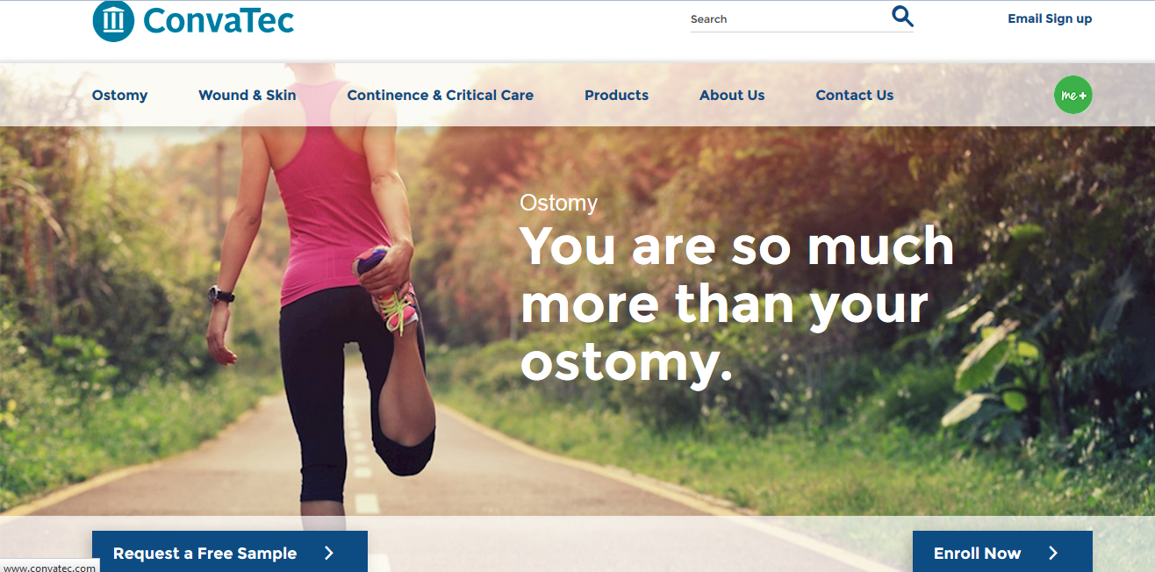
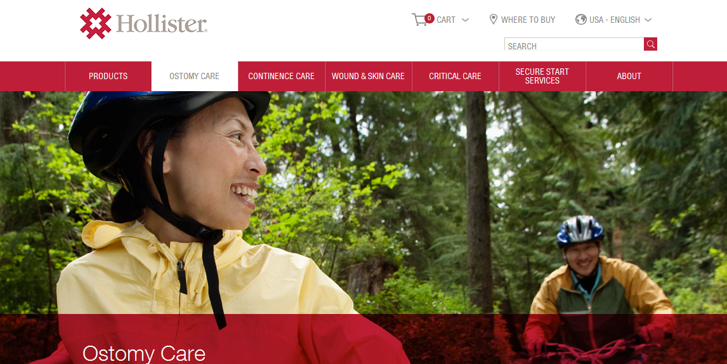
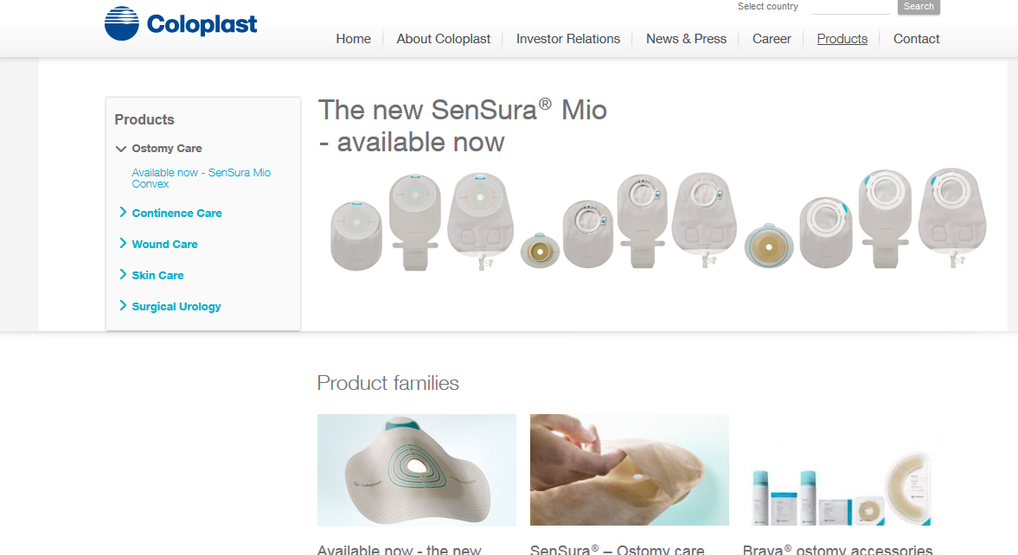
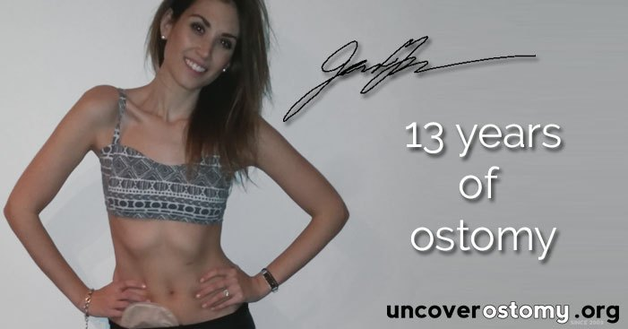
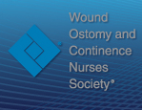
Stoma informatie op het internet
Bronnen van fabrikanten
Beroepsverenigingen
Patientenverenigingen
Onafhankelijke bronnen
Notes:
There are a variety of resources on the internet for people today. They include industry resources, professional associations, Ostomy associations and independent resources such as The Stolen Colon and Uncover Ostomy
Possible Discussion:
Do you have sites you like to go to?
Do more and more of your patients visit the internet?

Slide 58
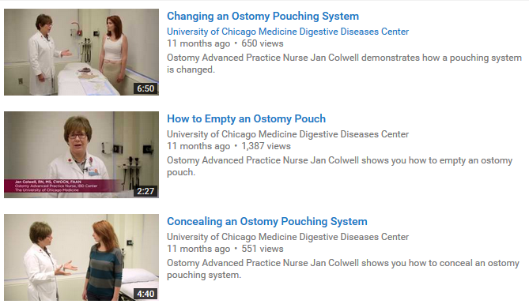
De impact op patiënten Casus
Met dank aan:
Notes:
This is a GREAT Example where a clinician has used you tube to educate
EXAMPLE: Jan Colwell at the university of Chicago has developed you tube videos that are can be accessed by her patients for additional teaching. They can also be accessed by the home care nurses.
NOTE: Try to keep the discussion to skin and PSCs.

Slide 59
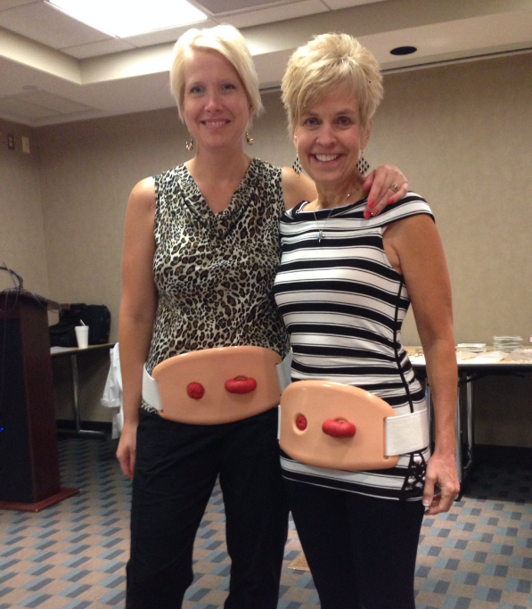
Het maximaliseren van de impact op patiënten Casus
Met dank aan:
Central DuPage Hospital
Northwestern Medicine
Winfield, IL
Notes:
What can you do to help maximize the impact with patients once they have been discharged home or an acute care setting. Here is just one example of a WOC nurse, Colleen Droslshagen at Northwestern Hospital in Illinois who developed a strong relationship with her community nurses to educate them for more positive outcomes for her patients once discharged.
They were getting a lot of complaints from patients that the home care nurses were not " experts " in ostomy care , were educating with wrong information and sending patients to the outpatient clinic with peristomal skin complications.
Colleen and her team gave feedback to the home care agency without being accusatory. They asked them to pick a team of nurses who are truly interested in wound and ostomy care. They conducted a pre-test to test their ostomy knowledge. And then planned 2 hours for ostomy and 2 for wounds educations.
The end result: They cleared up myths and misconceptions, gave them problem solving tips, a relationship with the ostomy nurses that was non-threatening and referrals to the ostomy clinic that were timely and appropriate.
Some other disucssion topics may include:
Collaboration with home care agency
Education
Discharge checklist
Teaching
Telemedicine

Slide 60
Jouw inzet
Notes:
Can you make a commitment to make a change in the post-discharge period that would impact peristomal skin health?
What impact can you make???
Possible discussion Topics are:
Assessment
Physical Assessment – Implementing a guide
Product Selection FIT – formulary charts
Education
Discharge Lists
Educational Resources (convexity assessment guide)
Go Pro Video Technology
iPhone Video Technology
Pictures
Transition Programs

Slide 61
Het zorgpad
Preoperatief
Ziekenhuis
Na het ontslag
Leven met een stoma
Notes:
We will now focus on the patient living with an ostomy. They are on their own…

Slide 62
Wanneer begin je met informatie geven over stomale en peristomale problemen?
Vraag 19
Preoperatief
Post-operatief in ziekenhuis
Thuiszorg
Poliklinisch
Ik geef geen proactieve informatie over complicaties
Notes:
Possible Discussion Topics:
How do you get all this information to the patient if they are in the hospital for three days and you don’t ever see them again
How do you be pro-active in preventing peristomal skin complications by educating the patient
Are there creative ways to educate when you have short length of stay?
Answer E: “I do not proactively teach about complications until a patient presents with one”

Slide 63
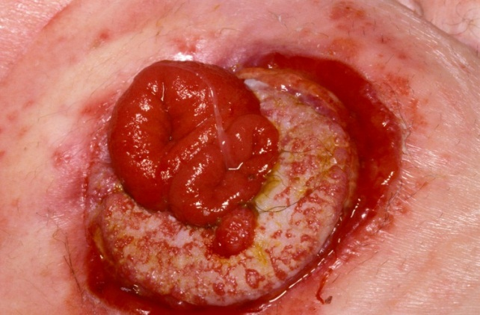
Wat kan er fout gaan?
Notes:
SAMPLE PICTURES – Please add your own to tell your own story
Tell a story abut a patient who has been discharged – ended up in trouble and returned to you with a PSC.
How long did they deal with it?
What did they do to manage it?
Did they know it was not normal?
Did they know who to call?
Was their life impacted/altered?

Slide 64
Wat patiënten zeggen
“input jos.”
Notes:
What do patients say? This is an actual true story – you can use this one or make your own?
Patient called in saying he had a PSC. WOC nurse asked what do you do to your skin before you put your pouch on? This was the response

Slide 65
Casus: Leven met een stoma
Notes:
Case Study: You have permission to Use!
Patient had emergency surgery resulting in colostomy. The wound opened and required negative pressure therapy. These are a series of pictures that tell a story.
This patient was discharged from home care and here is his story now. He is changing his pouch… but why is he wearing gloves? Did you not understand that he does not need to wear gloves?
What do you think they hear and remember?
Do you have a story to tell?

Slide 66
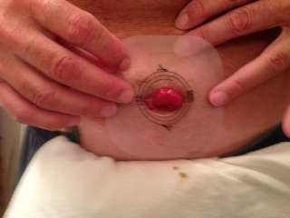
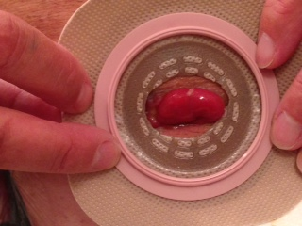
Casus: Leven met een stoma
Notes:
Here he is changing his barrier. He is using same stoma size as hospital. The stoma has changed but his pattern has not. The skin is now exposed and he is at risk for a peristomal skin complication!
What can we do to ensure they understand all the teaching in hospital?

Slide 67
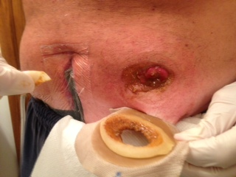
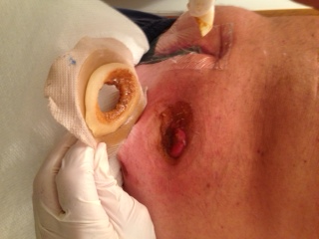
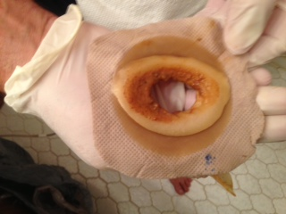
Casus: Leven met een stoma
Notes:
He reported getting four day wear time. This is what his barrier looked like on removal. He did not think he was getting leakage.
Was this appropriate?
Should you have changed sooner?
He is at risk for PSC but did not know anything was wrong!

Slide 68
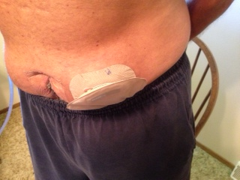
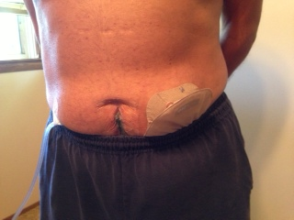
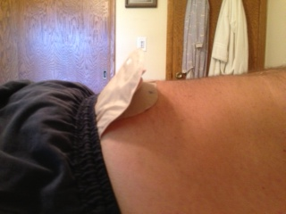
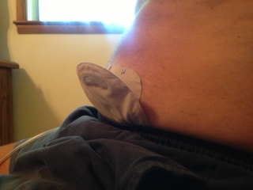
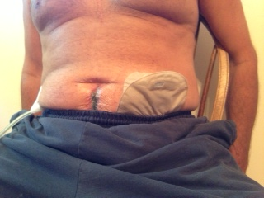
Notes:
Look at how he wears his clothes with his pouch – is he at risk for leakage? Leakage that would lead to a peristomal skin complication?

Slide 69
Het maximaliseren van de impact op patiënten Casus
Voeg een eigen casus toe over hoe je een verandering hebt doorgevoerd voor stomadragers wanneer deze eenmaal weer thuis waren.
Notes:
Do you have any examples of change in the community when the patient is living with the ostomy? You can add them here = Personalize!
Add your own example here:
UOAA
Sending letters to patients
Yearly educational events
- Follow up calls
- Manufacturer
Yearly educational events at your facility
Retailers / Distributors
UOAA

Slide 70
Jouw inzet
Notes:
Can you make a commitment to make a change in the living with an ostomy that would impact peristomal skin health?
What impact can you make???

Slide 71
Het zorgpad Het onderhouden van een gezonde peristomale huid
Preoperatief
Ziekenhuis
Na het ontslag
Leven met een stoma
Notes:
So this is the continuum of care.
We have identified Gaps along the continuum where people with an ostomy come at risk for peristomal skin complications

Slide 72
Informatie over de spreker
Naam:
Emailadres:

