Slide 1
The role of poor prognostic factors and RA progression
Prof. Georg Schett

Slide 2
Topics
The nature of ACPAs
Principle of protein citrullination
From citrullination to ACPA
Pathophysiologic role of ACPA
ACPA, anti-citrullinated protein antibody.

Slide 3
Anti-modified protein antibody response: Discovered more than 50 years ago
Anti-perinuclear
factor
Nienhuis RLF, et al. Ann Rheum Dis. 1964;23:302–5.

Slide 4
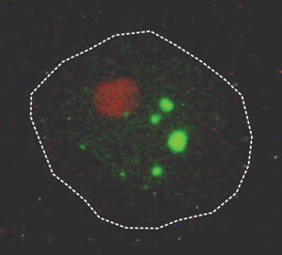
Anti-perinuclear factor
Staining of granules adjacent to the nucleus in human buccal mucosa epithelium¹
Waaler–Rose and Latex-fixation tests in 74 APF (+) patients²
Diagnosis |  | Waaler–Rose & Latex test |  | Waaler–Rose test |  | APF (+)
 |  | (+) | (-) | (+) | (-)
RA | Definite | 48 | 9 | 4 | 4 | 65
 | Probable & possible | 6 | 2 | – | – | 8
Systemic LE |  | 1 | – | – | – | 1
APF, anti-perinuclear factor; LE, lupus erythematosus.
Nienhuis RLF, et al. Ann Rheum Dis. 1964;23:302–5.; van Venrooij WJ, et al. Nat Rev Rheumatol 2011;7:391–8.

Slide 5
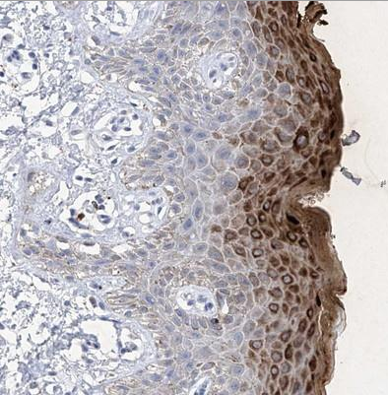
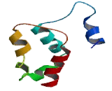
Anti-keratin antibodies
Positive staining of the Stratum corneum of rat esophageal epithelium by serum from patients with RA¹
Anti-keratin antibodies was a misnomer as the antibodies were not directed against keratin but filaggrin¹
The antigen was identified as filaggrin²
Filaggrin Ab staining of human vulva/anal skin shows strong cytoplasmic positivity in superficial layer of squamous epithelium³
Filaggrin⁴
Ab, antibody; RA, rheumatoid arthritis.
1. Young BJJ, et al. Br Med J. 1979;2:97–9; 2. Simon M, et al. J Clin Invest.1993;92:1387–93; 3. Filaggrin antibody staining of human vulva/anal skin. Available from: http://www.novusbio.com/Filaggrin-Antibody_NBP1-87527.html [Accessed February 2016]; 4. Filaggrin structure. Available from: http://www.uscnk.com/directory/Filaggrin%28FLG%29-8103.htm [Accessed February 2016].

Slide 6
Anti-filaggrin and APF are the same RA-specific antibodies
RA
serum
5.00
4.00
Anti-
Filaggrin
Ab
3.00
APF titer-like value
2.00
R=0.88
P <10^{–6}
1.00
Anti-
cytokeratin
Ab
0.00
0.00
2.00
4.00
6.00
8.00
AKA titer-like value
–
BSA
Filaggrin
Ab, antibody; AKA, anti-keratin antibody; APF, anti-perinuclear factor; BSA, bovine serum albumin; RA, rheumatoid arthritis.
Sebbag M, et al. J Clin Invest.1995;95:2672–9.

Slide 7
Several epitopes are recognized by ACPAs
Filaggrin 48–65
Fibrinogen B 246–267
Fibrinogen
Fibrinogen A 211–230
Fibrinogen A 582–599
Fibrinogen A 556–575
Fibrinogen A 616–635
Vimentin
H2B/a 62–81
H2A/a 1–20
Histones 2A
Histones 2B
Clusterin 221–240
Clusterin 231–250
Biglycan 247–266
Enolase 1A 5–21
Vimentin 58–77
Apolipoprotein E
Apolipoprotein E 277-296
Anti-CCP
Anti-CCP: a screening test covering several different ACPA responses
ACPA, anti-citrullinated protein antibody.
Taylor P, et al. Autoimmune Dis. 2011;2011:815038.

Slide 8
Prognostic value of ACPA in patients with recent-onset RA
Major advance in standardized diagnostic testing
In ~70% of RA patients, ACPA is present at the early stages of disease
ACPA (+) patients develop significantly more severe structural damage than those who are ACPA (-)
E
Cit
Cit
Q
Q
Q
S
R
H
C
C
G
ACPA, anti-citrullinated protein antibody; RAS, rheumatoid arthritis.
Kroot EJ, et al. Arthritis Rheum. 2000;43:1831–5.

Slide 9
Topics
The nature of ACPAs
Principle of protein citrullination
From citrullination to ACPA
Pathophysiologic role of ACPA
ACPA, anti-citrullinated protein antibody.

Slide 10
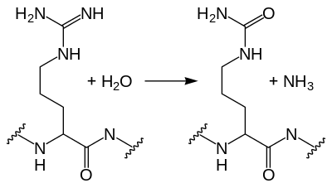
Citrullination is a process of protein modification
PAD
Arginine
Citrulline
PAD, peptidyl arginine deiminase.
van Venrooij WJ, et al. Arthritis Res. 2000;2:249–51.

Slide 11
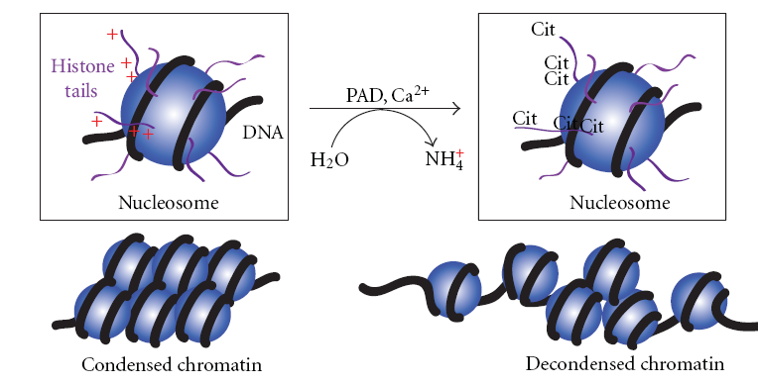
Histone H3 citrullination allows decondensation of the chromatin
+
Histone tails
+
+
PAD, Ca²⁺
+
+
+
DNA
+
H₂0
NH₄
H₂0
Nucleosome
Nucleosome
Condensed chromatin
Decondensed chromatin
PAD, peptidyl arginine deiminase.
Mohanan S, et al. Biochem Res Int. 2012;2012:895343.

Slide 12
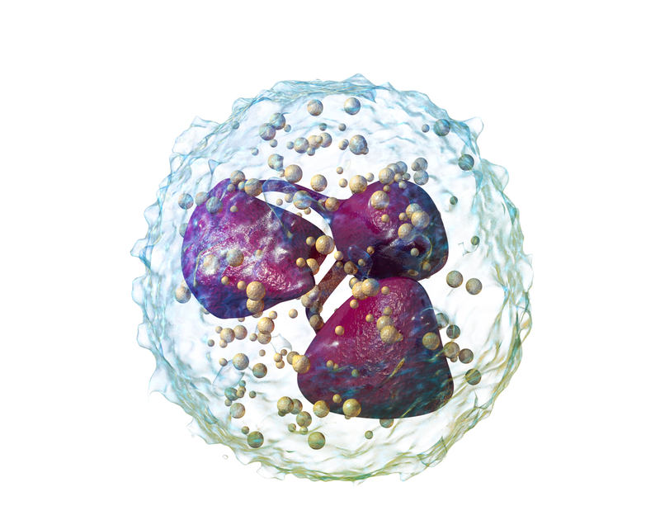
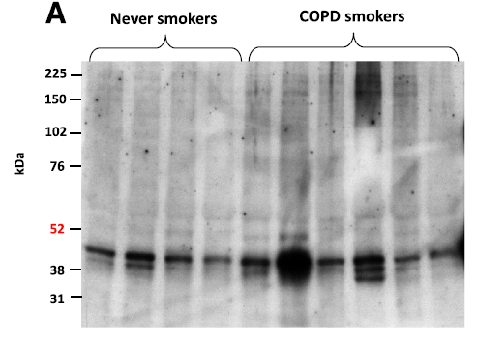
Stress response and citrullination
Histone citrullination is a response to inflammatory stimuli in neutrophils and determines essential neutrophil functions¹
Vimentin, is frequently citrullinated in metastasizing epithelial tumors and associated with tumor invasiveness^{2,3}
Stressed epithelial surfaces like the periodontium in periodontitis or the bronchial epithelium in COPD and smoking are citrullinated⁴
ACPA, anti-citrullinated protein antibody; IF PAD, peptidyl arginine deiminase.
Immunofluorescence image: Stadler SC, et al. Proc Natl Acad Sci USA. 2013;110:11851–6; immunoblots: Lugli EB, et al. Arthritis Res Ther. 2015;17:9; 1. Neeli I, et al. J Immunol. 2008;180:1895–902; 2. Brentville VA, et al. Cancer Res. 2016;76:548–60; 3. Stadler SC, et al. Proc Natl Acad Sci USA. 2013;110:11851–6; 4. Nesse W, et al. J Clin Periodontol. 2012;39:599–607.

Slide 13
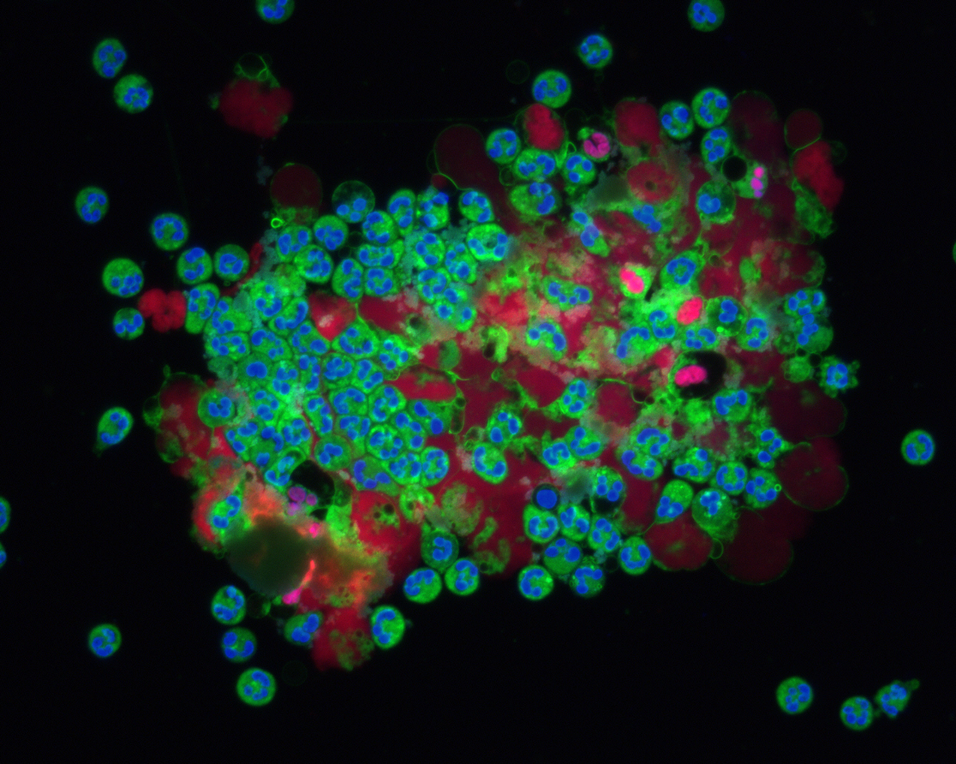
NETosis depends on citrullination and PAD enzymes
Decondensed
chromatin
NETosis is the release of NETs during a form of pathogen-induced cell death. NET, neutrophil extracellular trap.
Schett G, data on file. Image available at: http://www.nacht-der-wissenschaften.de [Accessed February 2016].

Slide 14
Protein citrullination in epithelial cancer
In breast cancer cells reduction of PAD4 expression dissociates tumor cell interactions
ACPA, anti-citrullinated protein antibody; IF PAD, peptidyl arginine deiminase.
Immunofluorescence image: Stadler SC, et al. Proc Natl Acad Sci USA. 2013;110:11851–6.

Slide 15
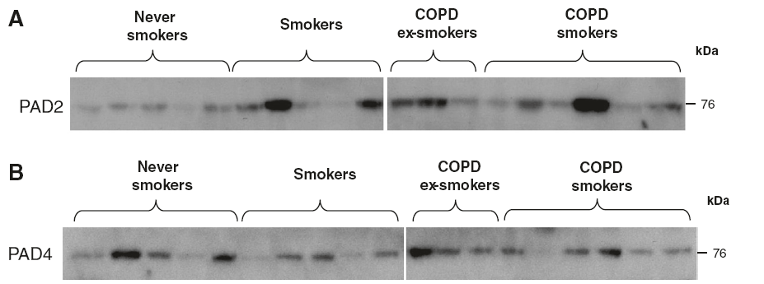
PAD expression in the lung
PAD2 and PAD4 are present in all lung tissues
COPD, chronic obstructive pulmonary disease; PAD, peptidyl arginine deiminase.
Lugli EB, et al. Arthritis Res Ther. 2015;17:9.

Slide 16
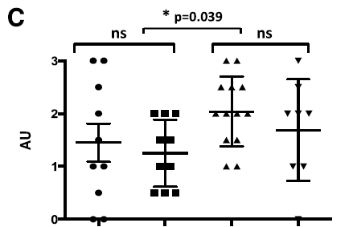
Stress-dependent citrullination of lung epithelium
Representative immunoblot of lung tissue lysates
Intensity of citrullinated proteins
Smoker Non-smoker Smoker Non-smoker
No COPD COPD
Citrullinated proteins are found in all lung tissue lysates
AU, arbitrary unit; COPD, chronic obstructive pulmonary disease; ns, not significant.
Lugli EB, et al. Arthritis Res Ther. 2015;17:9.

Slide 17
Topics
The nature of ACPAs
Principle of protein citrullination
From citrullination to ACPA
Pathophysiologic role of ACPA
ACPA, anti-citrullinated protein antibody.

Slide 18
Citrullination improved peptide binding to some HLA class II alleles and leads to T-cell activation
Relative affinities of Vim 65–77 and Vim R70Cit for purified MHC class II molecules
Analysis of the T-cell immune response
1
10
Vim 65-77
Vim 65-77
Vim R70Cit
Vim R70Cit
0.1
8
High affinity
6
MHC affinity (1/IC⁵⁰)
Stimulation index
0.01
4
0.001
Low / intermediate affinity
2
0.0001
0
*0101
*0401
*0404
*0301
*0701
*0802
*1101
*1302
0
10
50
100
HLA-DRB1 alleles
Peptide concentration (µg/ml)
MHC, major histocompatibility complex; Vim, vimentin.
Hill JA, et al. J Immunol. 2003;171:538–41.

Slide 19
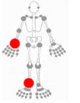
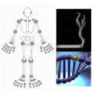
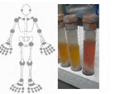
Classification and disease duration
Fulfilment of classification criteria
Swelling
Symptoms
‘Normal’
Inflammation
Rheumatoid
arthritis
Unclassified
arthritis
Genetic and environmental risk factors
Systemic autoimmunity
Symptoms
Phase A/B
Phase C
Phase D
Phase E
Phase F
0
3
6
9
Induction of autoimmunity
Maturation of the antibody response
No additional changes
Time from symptom onset (months)
Figure adapted from: van Steenbergen HW, et al. Arthritis Rheum. 2013;65:2219–32; Raza K, et al. Ann Rheum Dis. 2012;71:1921–3; Willemze A, et al. Nat Rev Rheumatol. 2012;8:144–52.

Slide 20
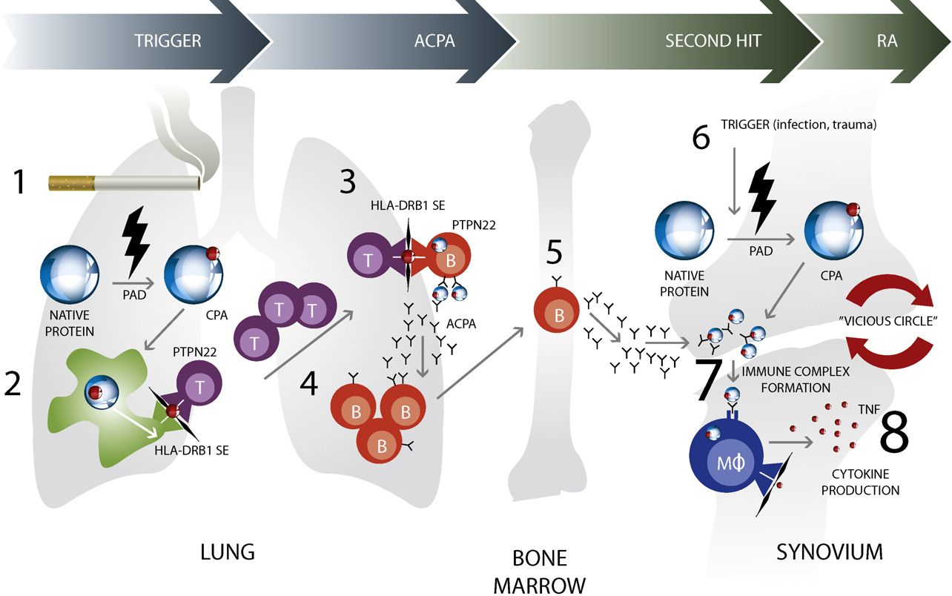
Moving from citrullination to ACPA
ACPA, anti-citrullinated protein antibody; CCP, cyclic citrullinated peptide; PAD, peptidyl arginine deiminase; RA, rheumatoid arthritis; TNF, tissue necrosis factor.
Klareskog L, et al. Annu Rev Immunol. 2008;26:651–75.

Slide 21
ACPA and RF precede RA
ACPAs and RFs in patients appear many years prior to RA onset¹
IgA RFs also appear in patients years prior to clinical symptoms²
60
50
40
IgM or ACPA
49.4%
30
Positive patients, %
40.5%
20
ACPA
10
27.8%
IgM-RF
0
15
14
13
12
11
10
9
8
7
6
5
4
3
2
1
0
Years before the start of symptoms
ACPA, anti-citrullinated protein antibody; Ig, immunoglobulin; RA, rheumatoid arthritis; RF, rheumatoid factor.
1. Nielen MM, et al. Arthritis Rheum. 2004;50:380–6; 2. Rantapää-Dahlqvist S, et al. Arthritis Rheum. 2003;48:2741–9.
Notes:
Talking Points
Adaptive immunity is involved in the production of autoantibodies such as ACPAs.¹ ACPAs are implicated in the initiation and development of RA.²
Here we present data that show that autoantibodies are present in RA patients before the onset of clinical symptoms. The cumulative percentages of patients with 1 or more positive test results for the indicated antibodies are indicated on the y axis, with the years before the start of symptoms on the x axis. The median time from the detection of IgM-RF or cyclic citrullinated peptide autoantibodies to symptom presentation was 2 and 4.8 years, respectively.³ Three isotypes of RF autoantibodies have been found in RA patients, and all 3 have been found prior to clinical symptom presentation.⁴
Background
ACPA: anticitrullinated protein antibody.⁵
References
1. Snir O, et al. Arthritis Rheum. 2010;62:44-52.
2. Bae S, et al. J Immunol. 2012;189:365-372.
3. Nielen MM, et al. Arthritis Rheum. 2004;50:380-386.
4. Rantapää-Dahlqvist S, et al. Arthritis Rheum. 2003;48:2741-2749.
5. McInnes IB, Schett G. N Engl J Med. 2011;365:2205-2219.

Slide 22
Topics
The nature of ACPAs
Principle of protein citrullination
From citrullination to ACPA
Pathophysiologic role of ACPA
ACPA, anti-citrullinated protein antibody.

Slide 23
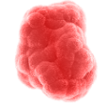
ACPAs form immune complexes to activate macrophages
Self-antigen
(citrullinated protein)
Immune complexes bind to Fc receptor
Macrophage activation and cytokine secretion
ACPA
Immune complexes
Activated macrophage
Proinflammatory
cytokines
ACPA, anti-citrullinated protein antibody.
Adapted from: Nimmerjahn F and Ravetch JV. Nat Rev Immunol. 2008;8:34-47.
Notes:
Antibodies bind to antigen and multiple antibodies can bind to a single antigen to form an immune complex¹
Immune complexes bind to macrophages and activate them to secrete proinflammatory cytokines^{1,2}
Immune complexes bind to the Fc receptors on the surface of macrophages¹
Reference
1. Nimmerjahn F & Ravetch JV. Nat Rev Immunol 2008;8:34-47.
2. Mathsson L, et al. Arthritis Res Ther 2006;8:R64.

Slide 24
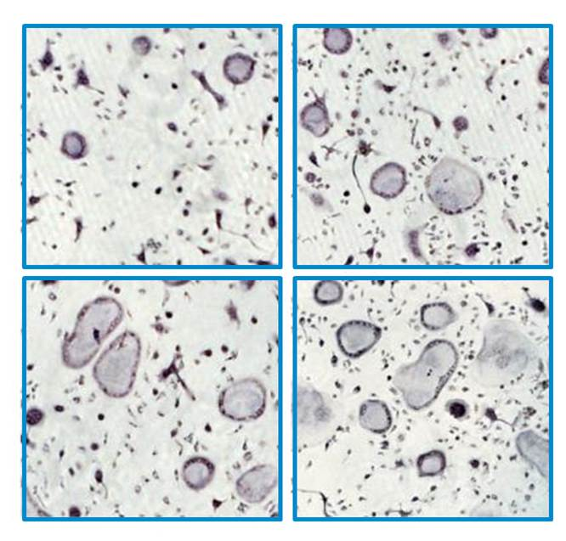
ACPA and osteoclast differentiation
Osteoclastogenesis
ACPA 0 ng/mL ACPA 1 ng/mL
80
60
*
*
*
N (osteoclasts)/well
40
20
0
Control
ACPA 1 ng/ml
ACPA 10 ng/ml
ACPA 100 ng/ml
Eluate 1 ng/ml
Eluate 10 ng/ml
Eluate 100 ng/ml
Bone resorption
80
60
*
*
% eroded surface
40
20
0
ACPA 10 ng/mL ACPA 100 ng/mL
Control
ACPA 1 ng/ml
ACPA 10 ng/ml
ACPA 100 ng/ml
Eluate 1 ng/ml
Eluate 10 ng/ml
Eluate 100 ng/ml
*P<0.05. ACPA, anti-citrullinated protein antibody.
Harre U, et al. J Clin Invest. 2012;122:1791–802.

Slide 25
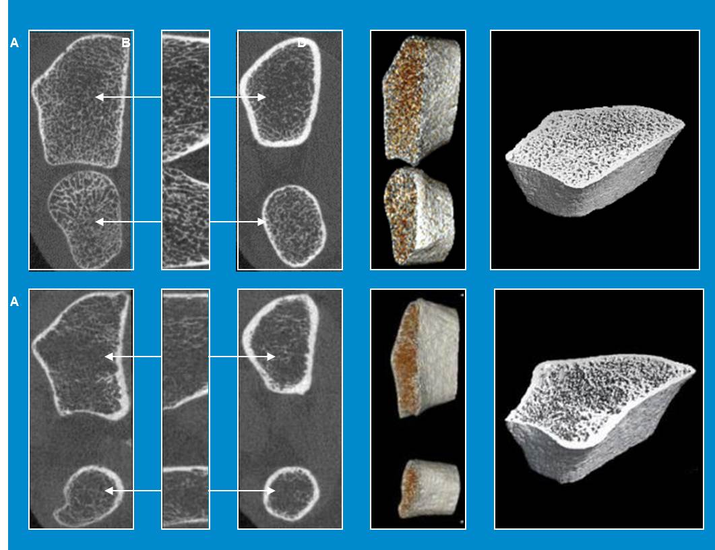
Effects of RA on trabecular bone structure
RA (-)
RA (+)
RA, rheumatoid arthritis.
Reproduced from: Kocijan R, et al. Ann Rheum Dis. 2014;73:2022–8.

Slide 26
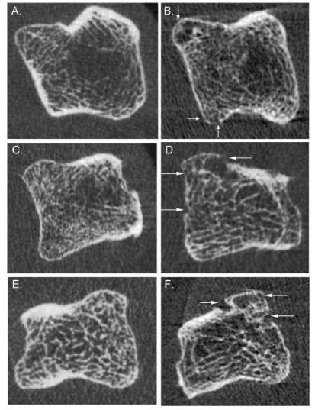
Changes in bone structure
Bone structure is altered in ACPA (+) non-arthritic individuals compared with ACPA (-) controls
Arrows show cortical thinning, cortical fenestration as well as small bone erosions.
ACPA, anti-citrullinated protein antibody.
Reproduced from: Kleyer A, et al. Ann Rheum Dis. 2014;73:854–60.

Slide 27
Interaction between ACPA and RF in RA-mediated bone loss
Y
Y
Y
Y
Y
P=0.020
Cumulative erosion volume
(mean, mm³)
P=0.039
ACPA, anti-citrullinated protein antibody; RA, rheumatoid arthritis; RF, rheumatoid factor.
Adapted from: Hecht C, et al. Ann Rheum Dis. 2015;74:2151–6.

Slide 28
Summary
RA-specific antibodies discovered more than 50 years ago
Protein citrullination identified as antigenic determinant in RA
Citrullination proposed as cellular response mechanism
ACPAs a key pathogenic step preceding the onset of clinical disease
Growing evidence of a direct pathophysiologic role of ACPAs in RA
ACPA, Anti-citrullinated protein antibody; RA, rheumatoid arthritis.

