Slide 1
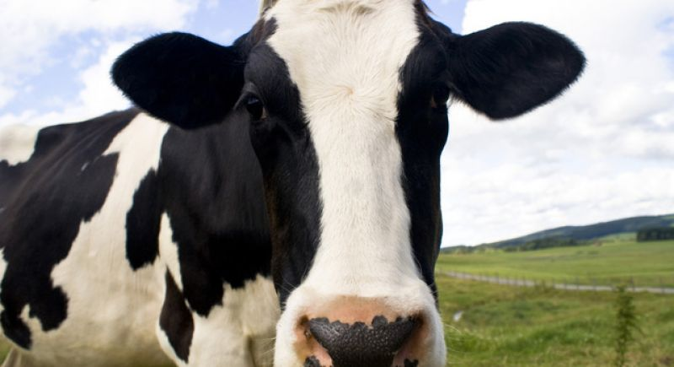
Advanced bone augmentation course Two days Master class on guided and customized bone augmentation procedures in the Netherlands
28-29 November 2019
Digital Implant Prosthodontics Academy

