Slide 1
Periodic fever syndromes: challenges and opportunities
Helen Leavis
internist-clinical immunologist
Dept. Rheumatology and Clinical Immunology
University Medical Center Utrecht, Netherlands
July 7th 2018
=

Slide 2
Disclosures
Shire: speakers fees, advisory board
Novartis: advisory board

Slide 3
Outline
4 fever cases
AoSD clinic and treatment
Monogenetic syndromes: FMF and HIDS
Take home messages

Slide 4
Fever case 1 36y old Caucasion male
Referred by gastroenterologist
Past medical history:
Correction cheilopalatoschisis 1984
From 1986 multiple episodes w recurrent arthritis and fevers, serositis > triggered by viral infections?
Recurrent viral infections and IgM and IgG2/4 subclass deficiency
2004 appendix sana
2013, 2015 pneumonia
2015/6 abdominal pain and fever, multiple admissons and exams in GE

Slide 5
Clinical features
Recurrent fever episodes
Abdominal pain
Airway disease
Started at early age
Also seen by Pediatrician WKZ long ago
Documented inflammation in lab
No abnormalities on endoscopy; recurrent pneumonia
Which DD?
What else to order / to do?

Slide 6
Differential diagnosis?
Immunodeficiency: Ab defect?
Inflammatory disease
Periodic fever syndrome
TRAPS
HIDS
CTD: SLE?
Metabolic: porphyria
Malignancy unlikely

Slide 7
Additional testing
Normal IgG-A-M
ANA neg, Lineblot neg
Vaccination response: very severe inflammatory skin reaction to Pneu23/Act Hib
IgD: +++
Genetics: compound heterozygous mutations in MVK gene

Slide 8
Diagnosis and treatment
HIDS
Prednison: incomplete resolution, cumulative dosage
Anakinra 1d100mg sc: very severe local reactions, no improvement on concurrent administration
Canakinumab 150 mg /8w: no fever attacks; week before injection mild malaise
Pm reduce interval

Slide 9
Fever case 2 29y Hindustan woman
Past medical history: depression, borderline personality, autointoxications
A/ persistent spiking fevers (2w), periodic salmon colored skin rash, initially painful throat, now artralgia and myalgia
Physical exam/ Fever peaks till 40.5C, tachycardia 120/m, Diffuse rash, mild arthritis PIP 2-4 R and L
DD?
Additional lab and examinations?

Slide 10
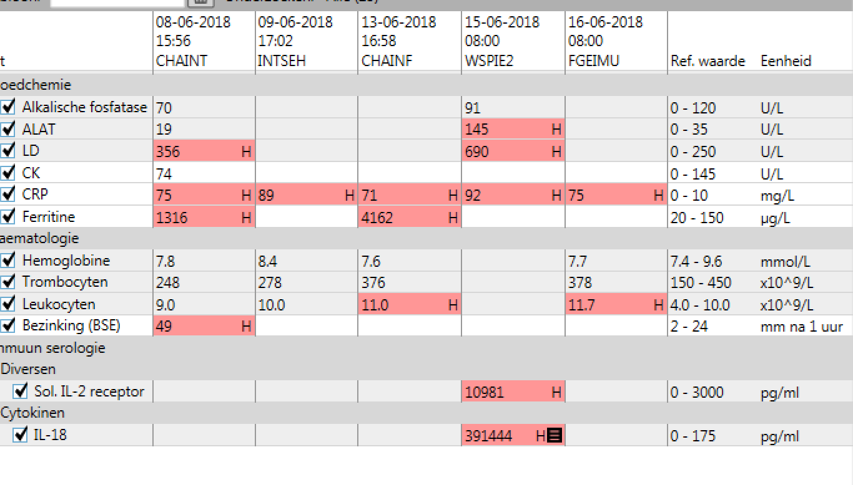
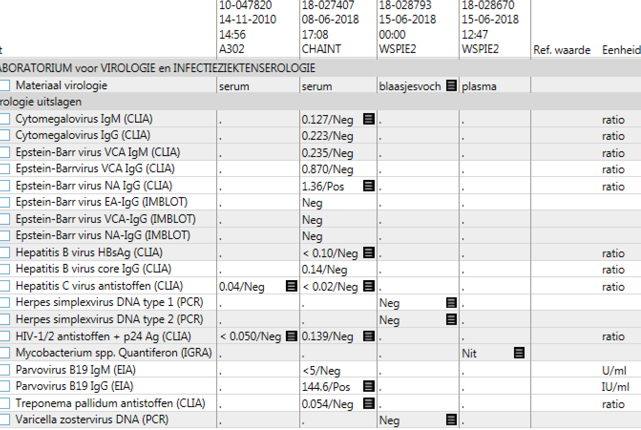

Slide 11
ANA weakly pos at 1:100, RF neg Lineblot: neg dsDNA neg C3/C4n
CT th-abd: no lesions, no lnn, no hepatosplenomegaly some reactive mediastinal lnn and one lnn in left axilla

Slide 12
Yamaguchi criteria
4 major: fever >1w, arthralgia, rash, leucocytosis >10
2 minor: sore throat, lymphadenopathy (mild)
No alternative diagnosis
Conclusion/ AoSD
Rx/ predn 60, quick tapering
Anakinra early when flare?

Slide 13
Case 3 42y old woman
Referred by clinical geneticist
Elsewhere ordered autoinflammatory NGS panel: negative
Past medical history
1980 Brugada: ICD
Horse accident
Since 2015 recurrent periodic fever with severe shivering and blue pallor
Traveled over world
No B-symptoms

Slide 14
Clinical Features
Frequency fever attacks differs from weekly to monthly
Cannot go to ER because of severe shivering
Documented attack: asymmetric rhythmic moving of arms, eyes open, no loss of consciousness
Lab once 1d after attack CRP 30; at each out patient hospital visit CRP 0

Slide 15
Documented lab results
lab 12-2-2016 BSE 16 IgA 5.38 ++ l 7.2 tr 213 l diff n
lab 27-2-2016 CRP 34 Hb 8.2 l 20.7 tr 163
lab 7-3-2016: CRP 2.8 IgD <64 mg/L, urine specimen unremarkable
lab 19-9-2016: l 21.5 CRP 61
lab 21-9-2016: CRP 25 hematology n
Which DD?
What else to do/to order?

Slide 16
Differential diagnosis
autoinflammatory (not monogenetic)
autoimmune: voltage gated potassium channelopathy?
malignancy?
infection? (ICD, but why intercurrent normal lab results)
‘Interuniversitaire Werkgroep Autoinflammatie’ consultation: prednison on demand or consider anakinra
Often underlying cause clear after some time
Notes:
Neuro: meestal oudere mannen

Slide 17
Consultation
Neurologist: film event: no epileptic insult, functional? advise: evaluate live in ER life events can trigger functional events?

Slide 18
What happened thereafter...
Temporarily discontinued prednison 30 mg on demand
Increased frequency of events
3rd event: called by AMC
My request blood cultures and evaluation by neurologist
No epileptic insult
Three positive BC CNS!

Slide 19
Underlying diseases
Admitted: PET scan: ICD lead infection but also abnormalities in breast
Sternotomy: revision ICD and leads
Currently undergoing breast cancer treatment

Slide 20
Case 4 62y old Caucasian male
SO 2016 idiopathic systemic disorder, diagnosis and therapy
Past medical history
Hypertension, gout, T2DM insulin dependance
2015 uveitis ant, later episcleritis
2015 aphthous lesion stomach (endoscopy), PPI
2015 hilar lnn, EBUS PA no lymphoma, immuno BAL unremark WD sarcoidosis, start prednison 30 mg
2016 skin inflammation, Sweet, predn 60
2016 arthralgia
2016-05 pneumonia, flare Sweet, PET positive left lower lung, skeleton, liver, mediast lnn, splenomegaly
Ear inflammation
Episode tromboflebitis

Slide 21
Clinical picture: inflammation
Initial broad DD systemic diseases, infections mostly excluded, multiple biopsies, no malignant disease
WD AoSD, anakinra, switched to canakinumab 150mgx8w because of local inflammation injection sites
Multiple episodes severe inflammation, fever and pancytopenia without hemolysis, Sweet, hepatosplenomegaly, ferritin + 2017
AoSD flare DD MAS
Tretaed with CS pulses and increased maintenance dosage
Bone marrow aspiration and biopsy; revision through hematology during clinical stay our center

Slide 22
Complicated by...
Severe back pain: HNP
Canakinumab 300 mg/4w
Revision BM: dysplastic characteristics, focal increase blasts; DD reactive (cytogenetics normal)
pm MDS treatment?, aIL6?
Hematology: referral local hematology dept for MDS treatment / allo SCT
1m later: IC admission, sepsis, Pseudomonas bullous cellulitis leg, on ventilator, vasopression
CRP decreased on AB en surgical treatment
But: pancytopenia, LDH +++, ALAT 237
No imaging, ferritin, Il1 blokkade interrupted

Slide 23
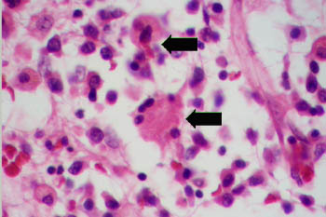
Diagnosis?
Obduction: revision focal hemofagocytosis in bone marrow
Consider secondary MAS/HLH
Postmortem MDS diagnosis very difficult; no genetic abnormalities
C/ therapy refractory AoSD; MAS triggered by severe infection?
MDS diagnosis referral unsuccessful/too late

Slide 24
Epidemiology of AOSD
nearly all countries and races¹
Estimated incidence rate for AOSD is 0.14–0.40 cases per 100,000 people²⁻⁵
Median age of diagnosis, 35 years (IQR: 23.6–45.4), with a range of 17–76 years⁷
Women 45–70% of patients²
AOSD, adult-onset Still‘s disease; IQR, interquartile range; SJIA, systemic juvenile idiopathic arthritis
1. Cush JJ. Bull Rheum Dis 2000;49:1–4; 2. Gerfaud-Valentin M, et al. Autoimmun Rev 2014;13:708–22; 3. Magadur-Joly G, et al. Ann Rheum Dis 1995;54:587–90; 4. Wakai K, et al. J Epidemiol 1997;7:221–5; 5. Evensen KJ, et al. J Rheumatol 2006;35: 48–51; 6. Ichiki H. Nihon Ronen Igakkai Zasshi 1992;29:960–4; 7. Novartis data on file [CACZ885DGR-EPI-01]

Slide 25
Innate immune pathways in AOSD clinical manifestations
IMMUNE SYSTEM DEFECTS
PUTATIVE TRIGGER
CLINICAL AND LABORATORY
MANIFESTATIONS
PAMPs:
Bacteria
Viruses
Fungi/parasites
DAMPs:
Chemicals/toxics
ATP and ROS
Serum activator?
ER stress ?
Treg
IL-6
Th17
TLR7
IL-23
Th17
IL-17
Th17
Arthritis, neutrophilia,
and skin rash
Fever, arthritis, hepatitis,
hyperferritinemia, coagulopathy, and ESR/CRP
Neutrophilia and splenomegaly
Fever, coagulopathy, arthritis, and weight loss
IL-1β: fever, rash, and ESR/CRP
IL-18: arthritis, hepatitis, and
hyferritinemia
TLR9
IL-8
Dendritic cells
Neutrophils
NLRP3
IL-18
IL-1b
Th1
IL-6
Th1
IL-8
Th1
TNF-α
Macrophages
TLR4
No familial aggregation
HLA-Bw35, -DR2, -DR4, and -DRB1
Polymorphisms: MIF, IL-18, PERF1, and Munc13-4
Multiple susceptibility alleles
S100
A8/A9
Activated
macrophages
IFN-γ
Neutrophils
MAS
CD8+
NK
NK
GENETIC SUSCEPTIBILITY
CD8+
NK
IL-10
AOSD, adult-onset Still’s disease; ATP, adenosine triphosphate; CRP, C-reactive protein;
DAMPs, danger-associated molecular patterns; ESR, erythrocyte sedimentation rate; HLA, human leukocyte antigen; IL, interleukin;
MAS, macrophage activation syndrome; NK, natural killer; NLRs, Nod-like receptors; PAMPs, pathogen-associated molecular patterns;
TNF, tumor necrosis factor; TLRs, Toll-like receptors; Treg, regulatory T cell
Jamilloux Y, et al. Immunol Res 2015;61:53–62.
Notes:
Current conception of AOSD pathogenesis. Environmental signals (pathogen-associated molecular patterns [PAMPs] or danger-associated molecular patterns [DAMPs]) set fire to the innate immune receptors (Toll-like receptors [TLRs] or Nod-like receptors [NLRs]), which in turn trigger the activation and secretion of inflammatory cytokines (i.e., IL-1β, IL-18, and IL-6). Subsequently, Th1 and Th17 adaptive responses are mounted.
Downstream of IL-1β and IL-18, IL-8, IL-6, and TNF-α, along with IL-17, are responsible for the clinical manifestations observed in AOSD. In AOSD, natural killer (NK) cells have deficient cytotoxic functions. NK-mediated interferon (IFN)-c production results from IL-18 stimulation and increases macrophage activation, leading to Macrophage activation syndrome (MAS; reactive hemophagocytic lymphohistiocytosis [reHLH]), a life-threatening complication of AOSD.

Slide 26
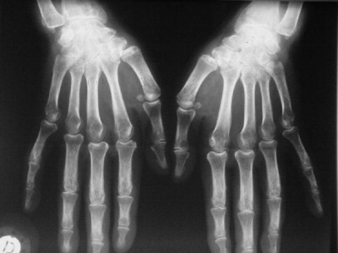
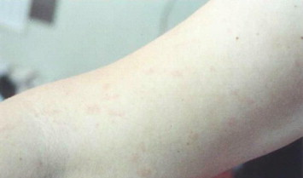
Clinical manifestations of AOSD
Most common clinical features
Other clinical features
Joint pain
Most common symptom (70–100% of patients)
Arthralgia and arthritis predominantly involving wrists, knees, ankles
Arthritis is initially mild and transient, but could evolve into chronic, destructive, symmetrical polyarthritis
Sore throat
(70%)
Enlargement of the lymph nodes
(50%)
Myalgia
(45%)
Splenomegaly
(40%)
Fever
Occurs in 60–100% of patients
Typically spikes daily or twice daily (quotidian*; highest temperatures {>39º C} occurs in the evening)
Precedes the onset of other manifestations
Hepatomegaly
(30%)
Weight loss
(27%)
Pleurisy
(21%)
Abdominal pain (18%)
Skin rash
Macular or maculopapular evanescent salmon-pink skin rash appears together with the fever spikes (60–80%)
Predominantly found on proximal limbs and trunk
Pericarditis
(16%)
*Occurring every day
Gerfaud-Valentin M, et al. Autoimmun Rev 2014;13:708–22; Fautrel B. Best Pract Res Clin Rheumatol. 2008;22:773–92.

Slide 27
Laboratory abnormalities associated with AOSD flares: percentage of AOSD patients affected
Neutrophilia
(56–89%)
High WBC
(≥10⁴/mm³)
(72–94%)
High CRP
(>1.0 mg/dL)¹
(66–97%)
Laboratory features
Anemia
(18–69%)
High ESR
(90–100%)
Elevated liver enzymes
(64–76%)
High ferritin
>500 μg/L
(69–97%)
Laboratory features suggest systemic inflammation
AOSD, adult-onset Still’s disease; CRP, C-reactive protein; ESR, erythrocyte sedimentation rate; WBC, white blood cell
Gerfaud-Valentin M, et al. Autoimmun Rev 2014;13:708–22. 1. Chen D-Y, et al. J Rheumatol 2004;31:2189–98.

Slide 28
Serious complications in AOSD
Rare clinical manifestations
└► | Fulminant hepatitis
└► | Myocarditis and myocardial necrosis
└► | Pulmonary involvement Pleurisy, temporary infiltrates, ARDS, and restrictive pulmonary disease
└► | Pure red cell aplasia
└► | Inappropriate ADH secretion and low sodium level
└► | Serositis
└► | Meningitis (aseptic) with neutrophilic pleiocytosis and stroke
└► | Disseminated cerebral thrombotic microangiopathy
└► | Fatal infections
Other major complications
└► | Macrophage activation syndrome, also known as reactive hemophagocytic syndrome
└► | Disseminated intravascular coagulopathy
└► | Thrombotic thrombocytopenic purpura
└► | Diffuse alveolar hemorrhage
└► | Pulmonary arterial hypertension
└► | Septic shock
ADH, antidiuretic hormone; AOSD, adult-onset Still’s disease; ARDS, acute respiratory distress syndrome
Kadavath S, et al. Ann Med 2015;47:6–14.

Slide 29
AOSD: diagnostic criteria
Yamaguchi et al
(1992)
Fautrel et al
(2002)
Cush et al
(1987)
Major criteria
Fever ≥39°C (≥1 week)
Arthralgia (≥2 weeks)
Typical rash
Leukocytosis (≥10,000/mm³) with ≥80% of granulocytes
Major criteria
Spiking fever ≥39°C
Arthralgia
Transient erythema
Pharyngitis
PMN ≥80%
GF≤20%
Major criteria
Quotidian fever >39°C
Skin rash
WBC count >12,000/mm³ + ESR >40 mm/h
Negative RF and ANA
Carpal ankyloses (2 points for each)
Minor criteria
Sore throat
Lymphadenopathy and/or splenomegaly
Liver dysfunction
Negative RF and ANA
The most commonly used diagnostic criteria
for AOSD are those published by Yamaguchi et al.
Minor criteria
Typical rash
Leukocytosis ≥10,000/mm³
Minor criteria
Onset <35 years
Arthritis
Prodromal sore throat
RES involvement or hypertransaminasemia
Serositis
Cervical or tarsal ankyloses (1 point for each)
Diagnosis requires:
≥4 major criteria or 3 major criteria + 2 minor criteria
Exclusion criteria
Infections, malignancies, rheumatic diseases
Diagnosis requires
≥5 criteria, including ≥2 major criteria
Probable diagnosis
10 points with 12 weeks of observation
Definite AOSD
10 points with 6 months of observation
ANA, anti-nuclear antibodies; AOSD, adult-onset Still’s disease; ESR, erythrocyte sedimentation rate; GF, glycosylated ferritin; PMN, polymorphonuclear; RES, reticuloendothelial system; RF, rheumatoid factor; WBC, white blood cell
Colafrancesco S, et al. Expert Rev Clin Immunol 2015;11:749–61.

Slide 30
Differential diagnosis
Diagnosis of AOSD is primarily about excluding other conditions^{1,2}
Infectious diseases/malignancies are the main conditions that need to be ruled out
Infections
Pyogenic infections including sepsis
Infectious endocarditis
Occult infections
Brucellosis, tuberculosis, yersiniosis
Viral hepatitis
Malignancy
Hodgkin’s disease or non-Hodgkin lymphoma
Solid cancers: kidney, colon, lung
Myeloproliferative disorders
Angioimmunoblastic lymphadenopathy
Paraneoplastic syndrome
Systemic diseases
Polyarteritis nodosa
Vasculitides
Polymyositis, dermatopolymyositis, systemic lupus
Seronegative rheumatoid arthritis
Sarcoidosis
Post-streptococcal arthritis or other reactive arthritis
Sweet’s syndrome
Hereditary autoinflammatory syndromes
Whipple disease
Drug-related hypersensitivity syndrome or pseudo-lymphoma
Schnitzler’s syndrome
AOSD, adult-onset Still’s disease
1. Colafrancesco S, et al. Expert Rev Clin Immunol 2015;11:749–61; 2. Kadavath S, et al. Annals of Medicine 2015;47:6–14.

Slide 31
Clinical course of AOSD
Features | Course and Prognosis | Frequency
Singly-occurring episode of illness with systemic symptoms such as fever, exanthema, serositis, and organ enlargement | Self-limiting, monocyclic (monophasic) course: complete remission within 2–4 weeks | 21–33%
Recurring relapses with or without joint involvement | Intermittent or polycyclic course: complete remission can last for 2 weeks or even 2 years | 17–44%
Persistent active disease with polyarthritic or oligoarthritic joint involvement | Chronic articular course | 26–43%
Fever/systemic
Joint
AOSD, adult-onset Still’s disease
Gerfaud-Valentin M, et al. Autoimmun Rev 2014;13:708–22; Kadavath S, et al. Ann Med 2015;47:6–14.

Slide 32
Systemic and articular AOSD
The disease course of refractory AOSD can be categorized into 2 subsets
Systemic | High fever High levels of liver enzymes High acute phase reactants | Predictive factors | Female sex Proximal arthritis at disease onset Thrombocytosis Corticosteroid dependency | Articular
 | IL-1β, IL-18, IFN-α/β, IFN-γ, IL-4 | Immune profile | IL-17, IL-23, TNF-α, IL-6
 | High fever Hepatitis Serositis Macrophage activation syndrome | Other clinical features | Fever may not be present Arthritis Joint destruction
AOSD, adult-onset Still’s disease; IFN, interferon; IL, interleukin; TNF, tumor necrosis factor
Jamilloux Y, et al. Ther Clin Risk Manag 2014;11:33–43.

Slide 33
Significant influencing factors for disease course
Multicenter study in Turkey (19 rheumatology centers)
Initial data of 356 patients (210 females; 59%) were evaluated; median (range age, 32 (16-88) years; median (range) follow-up duration, 22 (0-180) months)
Delayed diagnosis of >6 months, failure to achieve remission with initial treatment, male sex, and arthritis involving wrist and/or elbow joints were found to be related to chronic disease course in AOSD
Influencing Factors | Disease Course |  |  | P Value (univariate) | P Value (multivariate)†
 | Monocyclic | Relapse* | Chronic
Male, n (%) | 50/117 (42.7) | 26/92 (28.3) | 31/46 (67.4) | <0.001 (chronic vs relapse) 0.035 (monocyclic vs relapse) 0.005 (monocyclic vs chronic) | <0.001(chronic vs relapse) 0.081 (monocyclic vs relapse) 0.020 (monocyclic vs chronic)
Delayed diagnosis for more than 6 months, n (%) | 12/116 (10.3) | 20/89 (22.5) | 17/46 (37.9) | 0.016 (monocyclic vs relapse) <0.001(monocyclic vs chronic) | 0.076 (monocyclic vs relapse) <0.007 (monocyclic vs chronic)
Induction of remission with initial treatment, n (%) | 106/116 (91.4) | 73/82 (89.0) | 21/43 (48.8) | <0.001 (chronic vs relapse) <0.001 (monocyclic vs chronic) | 0.011 (chronic vs relapse) 0.007 (monocyclic vs relapse) <0.001 (monocyclic vs chronic)
Arthritis in wrist joint, n (%) | 36/115 (31.3) | 46/92 (50.0) | 28/45 (62.2) | 0.020 (monocyclic vs relapse) <0.001 (monocyclic vs chronic) | 0.056 (monocyclic vs relapse) 0.003 (monocyclic vs chronic)
Arthritis in elbow joint, n (%) | 8/115 (6.9) | 10/92 (10.9) | 12/45 (26.7) | 0.018 (chronic vs relapse) 0.001 (monocyclic vs chronic) | 0.027 (chronic vs relapse) 0.009 (monocyclic vs chronic)
*Relapse = polycyclic †P value statistics from the multinomial logistic regression model with R²:0.36 and 59.3% correct classification
AOSD, adult-onset Still’s disease. Kalyoncu U, et al. J Autoimmun 2016;69:59–63.

Slide 34
Therapeutic strategy proposal in AOSD
Nonsteroidal anti-inflammatory drugs (indomethacin) during diagnostic workup
Confirmed AOSD (Yamagushi and Fautrel criteria could be helpful)
Corticosteroids 0.8–1 mg/kg/day
Steroid-sparing treatment: Methotrexate 7.5–20 mg/week
To consider early when patients show:
The first signs of steroid-dependence
Predictive factors for steroid-dependence (young age, splenomegaly, very low glycosylated ferritin, large ↑ in ESR)
Refractory AOSD
Complicated AOSD
Systemic AOSD
Predictive factors
Fever>39.5°C at onset
IL-18, IL-1, IL-6
Chronic arthritis
Predictive factors
Initial polyarthritis, erosive arthritis
IL-18, but IL-8. IFN-γ and TNF-α
Anakinra (anti‒IL-1)
Then consider tocilizumab (anti‒IL-6), multiple daily anakinra or long-acting IL-1 antagonists (canakinumab, rilonacept)
TNFα-blockers (prefer infliximab) or tocilizumab (anti‒IL-6)
Anakinra (anti‒IL-1) if systemic flares
Intravenous steroids
Intravenous immunoglobulins
Anakinra (anti‒IL-1)
Cyclophosphamide, cyclosporine, plasmatic exchanges, etoposide
AOSD, adult-onset Still’s disease; ESR, erythrocyte sedimentation rate; IL, interleukin, IFN, interferon; TNF, tumor necrosis factor
Gerfaud-Valentin et al. Autoimmunity Reviews 2014;13:708–22; Maria A.T.J. et al. Autoimmunity Reviews 2014;13:1149–59

Slide 35
Comparison of SJIA and AOSD characteristics: evolution and treatment
Features | SJIA | AOSD
Evolution
Monocyclic form | 40% | 30%
Polycyclic form | <10% | 30%
Chronic form | >50% | 40%
Carpal ankylosis | 28–50% | 45–55%
Destructive arthritis | 30% | 20–25%
Amyloidosis | Possible | Possible
Treatment
Cortiscosteroids efficacy | 50% | 60%
Response to anakinra | 50–100% | 50–100%
Response to tocilizumab | 71–85% | 60–80%
Response to anti-TNF | 30% | 25%
Associated complication
MAS | 7–10% | 12–17%
AOSD, adult-onset Still’s disease; MAS, macrophage activation syndrome; TNF, tumor necrosis factor; SJIA, systemic juvenile idiopathic arthritis
Jamilloux Y, et al. Immunol Res 2015;61:53–62.

Slide 36
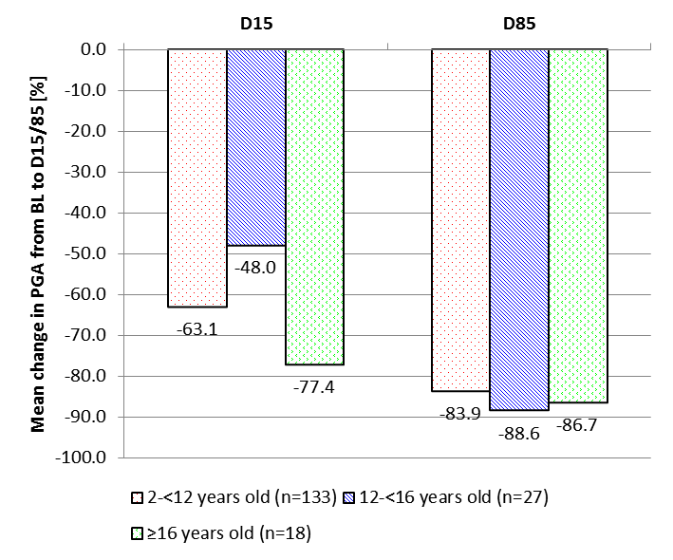
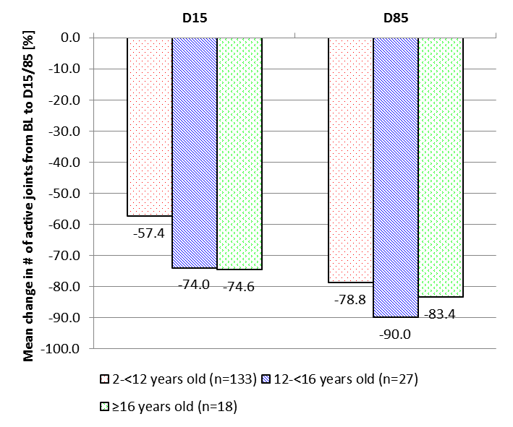
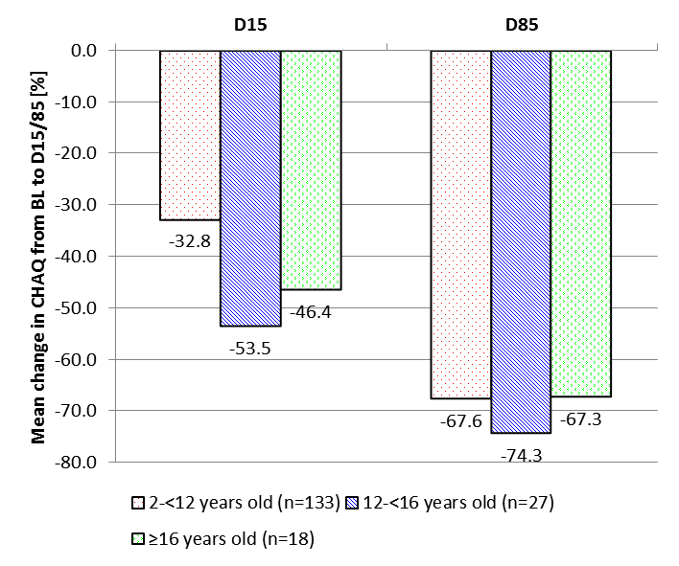
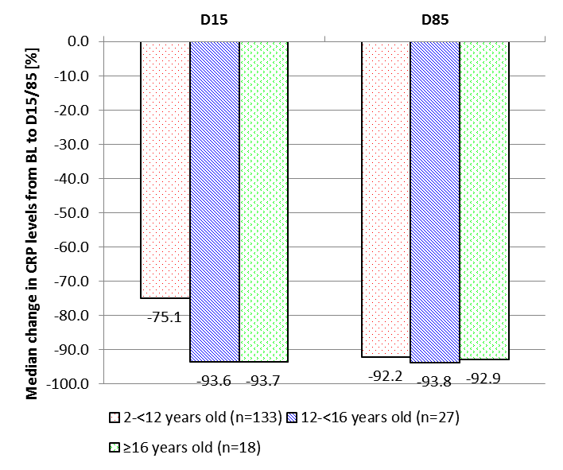
Canakinumab: efficacy in adolescent SJIA
Similar efficacy with canakinumab in adolescent Still’s disease compared with younger SJIA patients
Change in PGA (A), number of active joints (B), CHAQ (C), and CRP (D)
from Baseline to Day 15 and Day 85 by age group
A
B
C
D
A: Percentage mean change in PGA from Baseline to Day 15 and Day 85 by age group
B: Percentage mean change in number of active joints from Baseline to Day 15 and Day 85 by age group
Change from baseline included only subjects with a value at both baseline and post-baseline
C: Percentage mean change in CHAQ from Baseline to Day15 and Day 85 by age group
D: Percentage mean change in CRP from Baseline to Day 15 and Day 85 by age group Change from baseline included only subjects with a value at both baseline and post-baseline
Novartis Pharma AG, data on file.

Slide 37
M. Still and IL-1β inhibition
Anakinra
Rilonacept
Canakinumab
not available in Europe
IL-1 RA
IL-1ß
IL-1α
IL-1ß
IL-1ß
IL-1α
Anakinra
IL-1ß
IL-1 RI
IL-1 RAcP
IL-1 RI
IL-1 RAcP
IL-1 RI
IL-1 RAcP
No signal
transduction
No signal
transduction
No signal
transduction
Canakinumab approved by EMA for AOSD (08/2016)!
IL, interleukin
Lachmann HJ. Arthritis Rheum 2011;63:314–24.

Slide 38
Ongoing placebo-controlled clinical trial
Multicenter, placebo-controlled phase 2 study of canakinumab for the treatment of AOSD-core study, including an open-label, long-term extension
Investigator-initiated study being conducted in Germany
Long-term extension
Nonresponder Δ DAS ≤1.2 at week 12 safety follow up (no study drug)
Canakinumab 4 mg/kg body weight (max. 300 mg)/4 week sc
Responder Δ DAS >1.2 at week 12
Placebo
Responder Δ DAS >1.2 at week 12
Nonresponder Δ DAS ≤1.2 at week 12 Canakinumab 4 mg/kg body weight (max. 300 mg)/4 week sc (open)
V1 | V2 | V3 | V4 | V5 | V6 | V7 | V8 | End of core 2 | End of core 2
Week 1–4
W
eek 0
W
eek 4
W
eek 8
W
eek 12
W
eek 16
W
eek 20
W
eek 24
W
eek 28
W
eek 40
Baseline/
Study visit
Study visit
Primary
*1) If applicable,
*1) If applicable,
Secondary
*2) End of core
*2) End of core
Screening
randomization
with sc
with sc
endpoint
study drug
study drug
endpoints
study 1
study 2
blinded
administration
administration
*1) if applicaple,
(final
only applies to
study drug
of blinded
of blinded
study drug
administration)
verum
canakinumab
study drug
study drug
vs. placebo
AOSD, adult-onset Still’s disease; DAS, disease activity score; sc, subcutaneous; max, maximum; V, visit
Canakinumab for Treatment of Adult Onset Still's Disease (CONSIDER). ClinicalTrials.gov Identifier: NCT02204293. https://clinicaltrials.gov/ct2/show/NCT02204293. Accessed 26 June 2016.

Slide 39
Conclusions
AOSD is a rare inflammatory disorder characterized by daily spiking fever, arthritis, and typical salmon-colored rash; MAS is a serious complication in AOSD
A pivotal role is played by innate immune pathways; the major proinflammatory cytokines involved in AOSD are IL-1β, IL-18, IL-6 and TNF-α
AOSD can be divided into 2 distinct phenotypes based on cytokine profile, clinical presentation, and outcome:
Systemic AOSD
Articular AOSD
A comparison of the epidemiology, genetic, clinical presentation, and course suggests that SJIA and AOSD are 2 expressions of the same disease in different hosts, children and adults, respectively
Current treatment regimen is NSAIDs followed by corticosteroids and then steroid-sparing treatments; targeted biotherapies are the next line of treatment and have shown good management of AOSD
IL-1 blockade: anakinra, rilonacept, canakinumab
IL-6 blockade: tocilizumab
TNF-α blockade: etanercept, adalimumab, infliximab
AOSD, adult-onset Still’s disease; MAS, macrophage activation syndrome; NSAIDS, non-steroidal anti-inflammatory drugs; SJIA, systemic juvenile idiopathic arthritis; TNF, tumor necrosis factor

Slide 40
Periodic fever syndromes are group of autoinflammatory diseases
Recurrent attacks of fever; rash; pericarditis, pleuritis, abdominal serositis; lymphadenopathy; and musculoskeletal involvement
inherited PFS: genetic mutations lead to dysregulation of the innate immune system and to episodic systemic inflammation
The 3 classic PFS
FMF (familial Mediterranean fever)
HIDS/MKD (hyperimmunoglobulin D syndrome/mevalonate kinase deficiency)
TRAPS (tumor necrosis factor receptor-associated periodic syndrome)
CAPS generally presents with recurrent episodes of fevers, urticarial-like rash, and/or arthralgia/myalgia
De Jesus AA, Goldbach-Mansky R. Clin Immunol. 2013;147:155-174.
Notes:
Periodic fever syndromes (PFS) are a group of genetically diverse but clinically similar autoinflammatory diseases.
These syndromes are characterized by recurrent attacks of fever, rash, serositis, lymphadenopathy, and musculoskeletal involvement.
In PFS, genetic mutations lead to dysregulation of the innate immune system and to episodic manifestations of systemic inflammation.
The 3 classic PFS presenting with recurrent episodic fevers, nonspecific maculopapular rashes, and abdominal pain are
Familial Mediterranean fever (FMF)
Hyperimmunoglobulin D syndrome (HIDS)/mevalonate kinase syndrome (MKD)
Tumor necrosis factor receptor–associated periodic syndrome (TRAPS)
Reference
De Jesus AA, Goldbach-Mansky R. Monogenic autoinflammatory diseases: concept and clinical manifestations. Clin Immunol. 2013;147:155-174.

Slide 41
Distinguishing features of the more common PFS
 | FMF | HIDS/MKD | TRAPS | CAPS
 |  |  |  | FCAS | MWS | NOMID/ CINCA
Mode of inheritance | Autosomal recessive | Autosomal recessive | Autosomal dominant | Autosomal dominant | Autosomal dominant | Autosomal dominant
Age of onset, years | <10 | <6 months | Variable, most <7 | <1 | At birth | At birth
Predominant ethnic distribution | Eastern Mediterranean origins | North-Western European | All races | European | European | European
Gene involved | MEFV | MVK | TNFRSF1A | NLRP3 | NLRP3 | NLRP3
Duration of typical attack | 12 h‒3 days | 3‒6 days | 3 days‒3 weeks | <24 h | 1‒2 days | Persistent
Distinguishing symptoms | Severe peritonic or pleuritic pain, erysipelas-like skin lesion | Very young age at onset, cervical lymphadeno-pathy, apthous ulcers | Severe muscle pain, swelling around eye (periorbital edema) | Induction by cold exposure | Very young age at onset, sensorineural deafness | Very young age at onset, bone deformities, chronic meningitis
Response to colchicine | Yes | No | No | No | No | No
CAPS, cryopyrin-associated periodic syndromes; CINCA, chronic infantile neurologic cutaneous and articular syndrome; FCAS, familial cold autoinflammatory syndrome; FMF, familial Mediterranean fever; h, hour; HIDS, hyperimmunoglobulin D syndrome; MKD, mevalonate kinase deficiency; MWS, Muckle-Wells syndrome; NOMID, neonatal-onset multisystem inflammatory disease; PFS, periodic fever syndromes; TRAPS, tumor necrosis factor receptor−associated periodic syndrome
van der Hilst JCH, Frenkel J. Curr Rheumatol Rep. 2010;12:101-7.
Notes:
The table on this slide summarizes features of the six more common periodic fever syndromes.
Based on the age of symptoms onset, the length of fever attacks family history, ethnic background, and accompanying symptoms, most autoinflammatory syndromes can be differentiated on clinical grounds.
The periodic fever syndromes can be classified as autosomal recessive and autosomal dominant based on the type of inheritance.
In most cases, symptoms begin in early childhood, and occasionally in adulthood.
Among the three disorders, FMF and HIDS/MKD present with recurrent fever attacks of short duration (hours to days), while TRAPS presents with fever attacks of longer duration that can last weeks.
Reference
van der Hilst JCH, Frenkel J. Hyperimmunoglobulin D syndrome in childhood. Curr Rheumatol Rep. 2010;12:101-107.

Slide 42
Diagnosis is often challenging and relies on clinical suspicion; however, diagnostic delays are decreasing
PFS can be difficult diagnoses to establish and rely on clinical suspicion¹
Median diagnostic delay from symptom onset is reported to be:^{2,3}
FMF 1.8 years
TRAPS 5.8 years
HIDS/MKD 7.1 years
Many patients have seen multiple specialties and received incorrect diagnoses (e.g. FMF, AOSD, or JIA)
Eurofever registry data suggest a trend towards shorter diagnostic delay for autoinflammatory diseases in patients born more recently, reflecting genetic advances²
31
HIDS/MKD
CAPS
TRAPS
FMF
58
12
8
6
Diagnosis delay, years
25
25
21
15
15
51
50
15
28
40
225
Decade of birth
Delay in diagnosis has decreased substantially since the advent of genetic testing, but can still be challenging due to the rarity of the disease. Numbers denote number of patients.²
AOSD, adult-onset Still’s disease; CAPS, cryopyrin-associated periodic syndrome; FMF, familial Mediterranean fever; HIDS, hyperimmunoglobulin D syndrome JIA, juvenile idiopathic arthritis; MKD, mevalonate kinase deficiency; TRAPS, tumor necrosis factor receptor–associated periodic syndrome
1. van der Hilst JCH, Frenkel J. Curr Rheumatol Rep. 2010;12:101-107. 2. Toplak N, et al. Ann Rheum Dis. 2012;71:1177-1182.. 3. Ozen S, et al. Arthritis Care Res. 2017;4:578-586.
Notes:
Hyperimmunoglobulin D syndrome (HIDS) or mevalonate kinase deficiency (MKD) can be a difficult diagnosis to establish. The most important factor is high clinical suspicion.¹
A median diagnostic delay from symptom onset is reported to be nearly 10 years.¹ Many patients also receive an incorrect diagnosis (eg, familial Mediterranean fever (FMF), adult-onset Still’s disease, juvenile idiopathic arthritis) before being correctly diagnosed
Eurofever registry data suggest a trend towards shorter diagnostic delay for autoinflammatory diseases in patients born more recently. However, even in patients born in the 21st century, median diagnostic delay for HIDS/MKD patients is still relatively long (2.5 years).²
References
van der Hilst JCH, Frenkel J. Hyperimmunoglobulin D syndrome in childhood. Curr Rheumatol Rep. 2010;12:101-107.
Toplak N, Frenkel J, Ozen S, et al. An international registry on autoinflammatory diseases: the Eurofever experience. Ann Rheum Dis. 2012;71:1177-1182.

Slide 43
Therapeutic needs in autoinflammatory diseases
Effective therapy
Control of short-term symptoms
Prevention of long-term complications
Safe for lifelong use
Including children, pregnancy, and older ages
Well tolerated
Minimal drug interactions
Licensed for this indication
Affordable

Slide 44
FMF typically presents as acute fever accompanied by abdominal, chest, or joint pain
Manifestations of FMF¹⁻⁵
Duration of episodes¹ | 1−3 days
Classic features² | Recurrent, self-limited febrile episodes Painful abdominal inflammation (peritonitis) Painful chest inflammation (pleurisy) Arthritis/painful joints (arthralgia) Redness, swelling (erysipelas-like erythema)
Laboratory features² | Increased number of white blood cells (leukocytosis) ↑ ESR ↑ CRP, SAA
Complications^{2,4,5} | AA amyloidosis is the most serious complication of FMF Typically causes kidney dysfunction, but can also affect GI tract, liver, spleen, thyroid, and in much later stages, heart, and testes Renal amyloidosis was reported in 50% of untreated patients If untreated, may cause renal failure and early death
40
39
38
Body temperature (˚C)
37
36
0
1
2
3
Time (days)
Pattern of fever in FMF³
Jan
Feb
Mar
Apr
May
June
July
Aug
Sep
Oct
Nov
Dec
AA, Amyloid A; CRP, C-reactive protein; ESR, erythrocyte sedimentation rate; FMF, familial Mediterranean fever; GI, gastrointestinal tract; SAA; serum amyloid A
1. Samuels J, Özen S. Curr Opin Rheumatol. 2006;18:108-117. 2. Samuels J, et al. Medicine. 1998;77:268-297. 3. Simon A, et al. Familial autoinflammatory syndromes. In: Firestein G, et al, eds. Kelley's Textbook of Rheumatology. 8th ed. Philadelphia, PA: Saunders; 2008:1863-1882. 4. Zadeh N, et al. Genet Med. 2011;13:263-269. 5. Ben-Zvi I, et al. Isr Med Assoc J. 2012;14:221-224.
Notes:
Familial Mediterranean fever (FMF) usually presents before age 20 years.¹
Attacks occur without a characteristic pattern and resolve spontaneously within 3 days, leaving patients clinically asymptomatic between attacks.¹
FMF typically presents as acute episodes of fever accompanied by complaints of abdominal pain, chest pain, or joint pain.²
Erysipelas-like erythema is considered to be the most characteristic cutaneous lesion.²
The tender lesions appear as erythematous, warm, swollen areas 10‒15 cm in diameter and usually occur below the knee on the anterior leg or the dorsum of the foot (unilaterally or symmetrically).
Common laboratory findings during flares include leukocytosis with a left shift, an elevated erythrocyte sedimentation rate (ESR), and increased acute-phase reactants (C-reactive protein [CRP], serum amyloid A [SAA], fibrinogen, haptoglobin, and complement 3 and 4).²
Patients may also have transient albuminuria and microscopic hematuria during episodes.
AA amyloidosis, caused by deposition of SAA protein, is the most serious complication of FMF, most commonly affecting the kidney. AA protein deposits can also infiltrate the adrenals, intestine, spleen, and liver, and less commonly the lung, thyroid, heart, stomach, and testes. Renal amyloidosis was reported in 50% of untreated patients. If untreated, AA amyloidosis may cause renal failure and early death.^{2,4,5}
The figure on this slide shows the characteristic pattern of body temperature during an inflammatory attack in FMF.³
References
Samuels J, Özen S. Familial Mediterranean fever and the other autoinflammatory syndromes: evaluation of the patients with recurrent fever. Curr Opin Rheumatol. 2006;18:108-117.
Samuels J, Aksentijevich I, Torosyan Y, et al. Familial Mediterranean fever at the millennium: clinical spectrum, ancient mutations, and a survey of 100 Americans referrals to the National Institutes of Health. Medicine. 1998;77:268-297.
Simon A, van der Meer JW, Drenth JPH. Familial autoinflammatory syndromes. In: Firestein G, et al, eds. Kelley's Textbook of Rheumatology. 8th ed. Philadelphia, PA: Saunders; 2008:1863-1882.
Zadeh N, Getzug T, Grody WW. Diagnosis and management of familial Mediterranean fever: integrating medical genetics in a dedicated interdisciplinary clinic. Genet Med. 2011;13:263-269.
Ben-Zvi I, Danilesko I, Yahalom G, et al. Risk factors for amyloidosis and impact of kidney transplantation on the course of familial Mediterranean fever. Isr Med Assoc J. 2012;14(4):221-224.

Slide 45
Colchicine is the primary treatment for preventing acute attacks
Colchicine Response in FMF Patients^{1,3}
Colchicine ¹
Reduces attack frequency, decreases severity, and shortens duration of attacks
Prevents, halts, or even reverses renal amyloidosis
failure to respond to colchicine mostly due to noncompliance¹⁻³
colchicine-resistant:
If >6 typical attacks/year or >3 typical attacks within 4−6 months⁴
If attacks are incomplete†, where an increase in ≥2 of 3 acute phase reactants (CRP, ESR, SAA) between attacks is mandatory⁴
If patients not responding to the maximum tolerated dose of colchicine⁵
Colchicine does not elicit response in 5%‒10% of FMF patients
Significantly
reduces no. of attacks in 20%‒30%
Prevents attacks in >60%
*Includes those patients who can not tolerate colchicine, those who can tolerate it but whose attacks don't stop or don't reduce sufficiently, and those who are contraindicated to taking colchicine. Colchicine resistant is not well understood by HCPs and not well accepted in the literature, which is why we are moving away for using the term. †<38°C; attack duration not <6 hours or >1 week; localized abdominal signs; or atypical distribution of arthritis.CRP, C-reactive protein; FMF, familial Mediterranean fever; ESR, erythrocyte sedimentation rate; SAA, serum amyloid A
1. Ozturk MA, et al. Clin Exp Rheumatol. 2011;29 (Suppl. 67):S77-86. 2. Ben-Chetrit E, Aamar S. Clin Exp Rheumatol. 2009;27 (Suppl. 53):S1-3. 3. Ben-Chetrit E, Levy M. Lancet. 1998;351:659-664. 4. Hentgen V, et al. Semin Arthritis Rheum. 2013;43:387-391. 5. Ozen S, et al. Ann Rheum Dis. 2016;75:644-651.
Notes:
Colchicine is the primary treatment for preventing acute familial Mediterranean fever (FMF) attacks. It reduces attack frequency, decreases severity, and shortens duration of acute attacks in most FMF patients.¹
Colchicine can prevent, halt, or even reverse renal amyloidosis.¹
Colchicine prevents attacks in >60% of patients and significantly reduces the number of attacks in 20–30%; however, 5‒10% of patients do not respond to therapy.¹
Noncompliance may be the main reason for “nonresponse;” 1 study reported that ~40% of patients receiving daily colchicine were noncompliant.²
Recently, an interdisciplinary group of French and Israeli physicians and geneticists analyzed the published data on practical questions on management of FMF and developed practical consensus recommendations to standardize the clinical management of FMF patients. Their expert consensus recommendation for colchicine resistance is defined on this slide.³
References
Ozturk MA, Kanbay M, Kasapoglu B, et al. Therapeutic approach to familial Mediterranean fever: a review update. Clin Exp Rheumatol. 2011;29(suppl 67):S77-86.
Ben-Chetrit E, Aamar S. About colchicine compliance, resistance and virulence. Clin Exp Rheumatol. 2009;27(suppl 53):S1-3.
Hentgen V, grateau G, Kone-Paut I, et al. Evidence-based recommendations for the practical management of Familial Mediterranean Fever. Semin Arthritis Rheum. 2013;43:387-391.

Slide 46
Ultimate goal of treatment in FMF is to obtain complete control of unprovoked attacks and reducing subclinical inflammation
Proposed algorithm for treatment of patients with FMF (includes recent EULAR recommendations)^{1,2}
FMF diagnosis
Attacks
controlled (for >5 years)
Start colchicine ≤0.5‒1.8 mg/day*
Persistent attacks or subclinical inflammation
Measure attack-free
SAA and CRP level
Increase dose up to 2.0 (children)‒3.0 (adults) mg/day
Elevated
Normal
Attacks
controlled
6 months
Attacks uncontrolled or amyloidosis
Increase dose up to 2.0 (children)‒3.0 (adults) mg/day
Continue treatment
(dose reduction may be considered)
Measure attack-free
SAA and CRP level
Colchicine (max dose) should be co-administered with biological therapies (anti-IL-1 agent)
Measure attack-free
SAA and CRP level
Elevated
Normal
Normal
Elevated
Measure attack-free SAA and CRP level
Continue treatment
(dose reduction may be considered)
Continue treatment
Look for causes of high SAA level
*<5 years of age: ≤0.5 mg/day (≤0.6 mg/day if tablets contain 0.6 mg); 5–10 years: 0.5–1.0 mg/day (1.2 mg/day if tablets contain 0.6 mg); >10 years:1.0–1.5 mg/day (1.8 mg/day if tablets contain 0.6 mg). In patients with amyloidosis or greater disease activity, higher doses may be initiated. Colchicine dose should be reduced in patients with decreased renal function or liver enzymes >2-fold the upper limit of normal.
CRP, C-reactive protein; FMF, familial Mediterranean fever; IFN, interferon; max, maximum SAA, serum amyloid A; TNF, tumor necrosis factor
1. Ben-Zvi I, Livneh A. Nat Rev Rheumatol. 2011;7:105-112. 2. Ozen S, et al. Ann Rheum Dis. 2016;75:644-651.
Notes:
The ultimate goal of treatment in familial Mediterranean fever (FMF) is to obtain complete control of unprovoked attacks and reducing subclinical inflammation, usually with colchicine; however, much evidence suggests that ongoing inflammation occurs in patients during attack-free periods, even while receiving colchicine.^{1,2}
Subclinical inflammation can have major clinical effects including impairment of daily activities, anemia and weakness, predisposition to atherosclerosis and coronary heart disease, and Amyloid A (AA) amyloidosis.¹
Ben-Zvi and Livneh argue that just eliminating acute attacks in patients with FMF may not be sufficient to achieve an optimal outcome and that therapeutic aims should be changed. Serum amyloid A (SAA) is considered to be useful inflammatory marker of FMF because its measurement is reliable and SAA has a direct role in AA amyloidosis pathogenesis.¹
Ozen et al. recommends that physicians should treat patients with the minimal colchicine dose required to reduce subclinical inflammation as reflected by normal SAA (<10 mg/L) and C-reactive protein (CRP) levels . The proposed algorithm is shown on this slide.
References
Ben-Zvi I, Livneh A. Chronic inflammation in FMF: markers, risk factors, outcomes and therapy. Nat Rev Rheumatol. 2011;7:105-112.
Ozen S, Demirkaya E, Erer B, et al. EULAR recommendations for the management of familial Mediterranean fever. Ann Rheum Dis. 2016;75:644-651.

Slide 47
Three IL-1 inhibitors have been used to treat FMF patients intolerant or resistant to colchicine
Name | Compound | Mechanism of action⁷ | Level of evidence in FMF⁸⁻¹⁰
Anakinra (Swedish Orphan Biovitrum)^{1,2} | Recombinant nonglycosylated human IL-1 receptor antagonist |  | Case reports; Eurofever registry data
Rilonacept (Regeneron)³ | Dimeric glycoprotein (IL-1 Trap) |  | 1 phase II randomized, double-blind study
Canakinumab (Novartis Pharma AG)⁴⁻⁶ | Fully human, selective anti-IL-1β monoclonal antibody |  | Phase III study, 2 phase II open-label, single-arm studies (1 in adults; 1 in children); case reports
AOSD, adult-onset Still’s disease; CAPS, cryopyrin-associated periodic syndromes; FCAS, familial cold autoinflammatory syndrome; FMF, familial Mediterranean fever; GA, gouty arthritis; HIDS/MKD, hyperimmunoglobulin D syndrome/mevalonate kinase deficiency; MWS, Muckle-Wells syndrome; NOMID, neonatal-onset multisystem inflammatory disease; sc, subcutaneously; SJIA, systemic juvenile idiopathic arthritis; TRAPS, tumor necrosis factor receptor associated periodic syndrome
1. Kineret® (anakinra) Package Insert. Swedish Orphan Biovitrum AB, 2012. 2. Kineret® (anakinra) SmPC. Swedish Orphan Biovitrum AB, 2012. 3. Arcalyst® (rilonacept) Package Insert. Regeneron, 2010. 4. Ilaris® (canakinumab) Package Insert. Novartis Pharmaceuticals Corp. 2016. 5. Ilaris® (canakinumab) SmPC. Novartis Europharm Ltd. 2016. 6. llaris® (canakinumab) Product monograph. Novartis Pharmaceuticals Canada Inc. 2016. 7. Lachmann H, et al. Arthritis Rheum. 2011:63;314-324. 8. Vitale A, et al. Mediators Inflamm. 2013;2013:939847. 9. ter Haar N, et al. Ann Rheum Dis. 2013;72:687-685. 10. De Benedetti F, et al. Ann Rheum Dis. 2016;75 (Suppl 2):615.
Notes:
This slide shows the three interleukin (IL)-1 inhibitors used in the treatment of familial Mediterranean fever (FMF). Canakinumab is the first and only US FDA-approved biologic treatment for patients with FMF, whereas anakinra and rilonacept have been used off-label.¹⁻⁶
Note the different mechanisms of action and dosing regimens for the 3 agents.⁷
Anakinra, a recombinant nonglycosylated human IL-1 receptor antagonist, is currently approved for rheumatoid arthritis (RA) and neonatal-onset multisystem inflammatory disease (the most severe phenotype of the cryopyrin-associated periodic syndromes [CAPS]) in the United States (US), and for RA and all 3 CAPS phenotypes in the European Union (EU).^{1,2} Evidence for benefit of anakinra in patients with FMF is based on case reports and Eurofever registry data.^{8,9}
Rilonacept, a dimeric glycoprotein, is approved for 2 CAPS phenotypes — familial cold autoinflammatory syndrome (FCAS) and Muckle-Wells syndrome (MWS) in the US.³ The role of rilonacept in the treatment of patients with FMF is based a small, phase II, randomized, double-blind study.⁸
Canakinumab, a fully human, selective anti-IL-1β monoclonal antibody, is approved for all 3 CAPS phenotypes in the European Union (EU) and Canada, and for FCAS and MWS in the United states (US). It is also approved for systemic juvenile idiopathic arthritis (US, EU) and for refractory gouty arthritis (EU). It has recently been approved for periodic fever syndromes (FMF, HIDS/MKD, and TRAPS) in the US.⁴⁻⁶ The benefit of canakinumab in patients with FMF has been demonstrated in a phase III study, 2 identical phase II, open-label, single-arm studies (1 in adults; 1 in children) and several case reports.^{9,10}
References
Kineret® (anakinra) Package Insert. Swedish Orphan Biovitrum AB, 2012.
Kineret® (anakinra) Summary of Product Characteristics. Swedish Orphan Biovitrum AB, 2012.
Arcalyst® (rilonacept) Package Insert. Regeneron, 2010.
Ilaris® (canakinumab) Package Insert. Novartis Pharmaceuticals Corp, 2013.
Ilaris® (canakinumab) Summary of Product Characteristics. Novartis Europharm Ltd, 2015.
llaris® (canakinumab) Product monograph. Novartis Pharmaceuticals Canada Inc., 2016.
Lachmann H, Quartier P, So A, Hawkins PN. The emerging role of interleukin-1β in autoinflammatory diseases. Arthritis Rheum. 2011:63;314-324.
Vitale A, Rigante D, Lucherini OM, et al. Biological treatments: new weapons in the management of mongenic autoinflammatory disorders. Mediators Inflamm. 2013;2013:939847.
ter Haar N, Lachmann H, Özen S, et al. Treatment of autoinflammatory diseases: results from the EuroFever Registry and a literature review. Ann Rheum Dis. 2013;72:678-685.
De Benedetti F, Anton J, Gattorno M, et al. A phase III, pivotal, umbrella trial of canakinumab in patients with auto-inflammatory periodic fever syndromes (colchicine-resistant FMF, HIDS/MKD and TRAPS). Ann Rheum Dis. 2016;75 (Suppl2):615.

Slide 48
FMF: summary
AR, most common PFS, eastern Mediterranean origins
mutations in the MEFV gene that encodes the protein cryopyrin
Attacks: fever; serositis; arthritis; rash; and severe abdominal pain
AA amyloidosis is the most serious complication, can be life threatening
Goals management: supportive treatment during attacks and prevention of future attacks
Colchicine is considered the standard of care for preventing future attacks as well as preventing AA amyloidosis
5–10% of patients do not respond to colchicine
Anti IL-1 therapy in patients unresponsive to colchicine or unable to tolerate it
FMF, familial mediterranean fever. PFS, periodic fever syndrome.
Notes:
This slide recapitulates the main points discussed in the FMF section.

Slide 49
HIDS/MKD is a rare PFS linked to a metabolic defect
rare autosomal recessive disease^{1,2}
Caused by mutations in MVK, a gene which encodes an enzyme involved in cholesterol metabolism and isoprenoid biosynthesis^{3,4}
In the PFS enzyme activity is ~10% of normal
>300 people worldwide have MKD, most of whom have the HIDS phenotype⁶
This may be an underestimate of real disease prevalence
Most HIDS/MKD patients white in Europe⁷⁻⁹
Estimated prevalence in the NL: 5–6:1,000,000 (probably higher)⁹
HIDS, hyperimmunoglobulin D syndrome; MKD, mevalonate kinase deficiency; MVK, mevalonate kinase
1. Prieur AM, Griscelli C. Sem Hop. 1984;60:163-167. 2. van der Meer JW, et al. Lancet. 1984;1:1087-1090. 3. Drenth JPH, et al. Nat Genet. 1999;22:178-181. 4. Houten SM, et al. Nat Genet. 1999;22:175-177. 5. Haas D, Hoffmann G. Orphanet J Rare Dis. 2006;1:13. 6. van der Burgh R, et al. Clin Immunol. 2013;147:197-206. 7. van der Hilst JCH, Frenkel J. Curr Rheumatol Rep. 2010;12:101-107. 8. Hyper-IgD and periodic fever syndrome (HIDS) Website. Autoinflammatory Alliance website. Accessed July 12, 2016. 9. Frenkel J, et al. Clin Exp Rheumatol. 2000;18:525-532.
Notes:
Hyperimmunoglobulin D syndrome (HIDS) is a rare, autosomal recessive disease.^{1,2}
The disorder is also known as ‘mevalonate kinase deficiency’ (MKD) after the discovery of the causative gene, mevalonate kinase, an intermediary enzyme in cholesterol metabolism and isoprenoid biosynthesis.^{3,4}
MKD also encompasses a more severe disorder known as ‘mevalonic aciduria,’ which in addition to severe fever episodes, causes cerebellar ataxia, mental retardation, failure to thrive, hematologic abnormalities, and often, early death. It has become clear that the genetic deficiency actually causes a spectrum of disease with strongly varying severity, largely related to the severity of the enzymatic defect.⁵
Based on registry data, >300 people worldwide have MKD, most of whom have the HIDS phenotype.⁶
However, this is an underestimate of real disease prevalence because many patients go undiagnosed.
Most HIDS/MKD patients are Caucasian and live in western Europe; majority are Dutch (55%) and French (25%).⁷⁻⁹
Estimated prevalence in the Netherlands: 5–6:1,000,000 (in reality, probably higher).⁹
Although the MVK gene mutation is uncommon, in the Netherlands at least 1:350 people carry the recessive gene.⁸
References
Prieur AM, Griscelli C. [Nosologic aspects of systemic forms of very-early-onset juvenile arthritis. Apropos of 17 cases.] Sem Hop. 1984;60:163-167.
van der Meer JW, Vossen JM, Radl J, et al. Hyperimmunoglobulineaemia D and periodic fever: a new syndrome. Lancet. 1984;1:1087-1090.
Drenth JPH, Cuisset L, Grateau G, et al. Mutations in the gene encoding mevalonate kinase cause hyper-IgD and periodic fever syndrome. Nat Gent. 1999;22:178-181.
Houten SM, Kuis W, Duran M, et al. Mutations in MVK, encoding mevalonate kinase, cause hyperimmunoglobulinemia D and periodic fever syndrome. Nat Genet. 1999;22:175-177.
Haas D, Hoffmann G. Mevalonate kinase deficiencies: from mevalonic aciduria to hyperimmunoglobulinemia D syndrome. Orphanet J Rare Dis. 2006;1:13.
van der Burgh R, Ter Haar NM, Boes ML, Frenkel J. Mevalonate kinase deficiency, a metabolic autoinflammatory disease. Clin Immunol. 2013;147:197-206.
van der Hilst JCH, Frenkel J. Hyperimmunoglobulin D syndrome in childhood. Curr Rheumatol Rep. 2010;12:101-107.
Mevalonate Kinase Deficiency (MKD) also known as Hyper IgD Syndrome (HIDS). Autoinflammatory Alliance website. http://autoinflammatory.org/hids.php. Accessed July 12, 2016.
Frenkel J, Houten SM, Waterham HR, et al. Mevalonate kinase deficiency and Dutch type periodic fever. Clin Exp Rheumatol. 2000;18:525-532.

Slide 50
Typical attack starts with prodromal symptoms followed by fever
Characteristic attack begins with preliminary (prodromal) symptoms, such as chills, malaise, and headache, followed by a spiking fever often >40°C¹
A combination of abdominal pain with vomiting, diarrhea, cervical lymphadenopathy, mouth ulcers, and/or muscoloskeletal symptoms almost always accompany attacks²
Fever subsides after 3‒6 days, and patient is asymptomatic until next attack^{1,2}
provoked by vaccinations, infections, or other physical or emotional stress often no obvious trigger³
Temporal fever pattern in a HIDS/MKD patient²
Body temperature, °C
Day
Jan
Feb
Mar
Apr
May
June
July
Aug
Sep
Oct
Nov
Dec
Note: Bar graph shows the number of attacks patient had in a year, when they occurred, and their approximate duration.
HIDS, hyperimmunoglobulin D syndrome; MKD, mevalonate kinase deficiency
1. van der Hilst JCH, Frenkel J. Curr Rheumatol Rep. 2010;12:101-107. 2. Drenth JPH, van der Meer JW. N Engl J Med. 2001;345:1748-1757.3. Korppi M, et al. Acta Paediatrica. 2011;100:21-25 .
Notes:
A characteristic attack of hyperimmunoglobulin D syndrome (HIDS) or mevalonate kinase deficiency (MKD) starts with prodromal symptoms, such as chills, malaise, and headache, followed by a spiking fever often >40°C. ¹
Cervical lymphadenopathy and abdominal pain with vomiting, diarrhea, or both almost always accompany the attack.²
Fever subsides after 3 to 6 days, and the patient is asymptomatic until the next attack.^{1,2}
The figure on this slide shows the temporal fever pattern in a patient with HIDS/MKD.²
References
van der Hilst JCH, Frenkel J. Hyperimmunoglobulin D syndrome in childhood. Curr Rheumatol Rep. 2010;12:101-107.
Drenth JPH, van der Meer JW. Hereditary periodic fever. N Engl J Med. 2001;345:1748-1757.

Slide 51
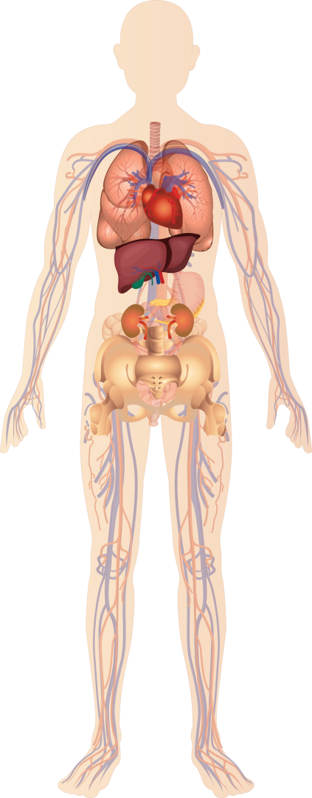
Fever attacks are accompanied by an array of signs and symptoms
General
Fever (100.0%)
Malaise (100.0%)
Headache (63.3%)
Cold chills (62.7%)
Lymphoid tissue
Swollen lymphadenopathy
Generally lymphadenopathy
Enlargement of the spleen (splenomegaly) (32.4%)
(87.4%)
Gastrointestinal
Vomiting (70.9%)
Diarrhea (71.6%)
Mucocutaneous
Maculopapular rash
Itching, redness (urticaria)
Dark spots on skin or mucous membranes (purpura)
Painful pink-to-blue nodules under skin (erythema nodosum)
Oral ulcers with or without genital ulcers (48.5%)
Abdominal
Abdominal pain (85.4%)
Enlargement of the liver (hepatomegaly) (21.6%)
Inflammation of lining of heart, lungs, other organs (serositis) (18.6%)
Abdominal adhesions (9.7%)
(68.9%)
Blood
↑ Acute phase reactants (CRP, ESR, SAA, blood leukocytes) during an attack
↑ IgD and IgA (often normal <3 years of age)*
↑ Urinary mevalonic acid concentration during acute attack
Joints
Arthralgia (83.5%) and/or arthritis (55.3%)
*Median IgD concentration is around 400 U/mL; in three quarters of patients, the elevated IgD concentration is accompanied by a rise in IgA; other immunoglobulins, including IgG subtypes are usually normal; IgD concentration does not correlate with disease activity. Ig, immunoglobulin.
van der Hilst JCH, et al. Medicine. 2008;87:301-310. 2. Korppi M, et al. Acta Paediatrica. 2011;100:21-25.
Notes:
Using the International hyperimmunoglobulin D syndrome (HIDS) Database, data for 103 patients with genetically-confirmed HIDS or mevalonate kinase deficiency (MKD) was collected to characterize the clinical features of HIDS/MKD.
Attacks of fever are accompanied by an array of signs and symptoms, which can be seen on this slide.
Reference
van der Hilst JCH, Bodar EJ, Barron KS, et al, for the International HIDS Study Group. Long-term follow-up, clinical features, and quality of life in a series of 103 patients with hyperimmunoglobulinemia D syndrome. Medicine. 2008;87:301-310.

Slide 52
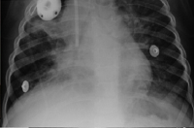
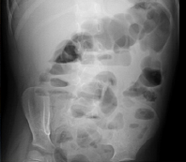
Long-term complications in HIDS/MKD
AA amyloidosis
Occurs in <3% of patients; has not been reported in children^{1,2-5}
Severe and/or recurrent bacterial infections (not related to immunosuppressive therapy)⁶
Occur in >25% of patients; include ear inflammation (otitis), bacterial infections of blood (septicemia), meningitis, pneumonia
Abdominal adhesions
Occur in ~10% of patients due to repeated peritonitis; can cause intestinal obstruction^{1,7}
Joint contractures
Occur in <4% of patients due to arthritis¹
Macrophage activation syndrome has been seen as a rare association with HIDS/MKD^{8,9}
Retinitis pigmentosa and renal angiomyolipomata have also been described
Bilateral pneumonia (top); acute intestinal obstruction due to peritoneal adhesions (bottom), in a HIDS patient⁶
AA, amyloid A: HIDS, hyperimmunoglobulin D syndrome; MKD, mevalonate kinase deficiency
1. van der Hilst JCH, et al. Medicine. 2008;87:301-310. 2. Obici L, et al. Arthritis Rheum. 2004;50:2966-2969. 3. Lachmann HJ, et al. Arthritis Rheum. 2006;54:2010-2014. 4. Siewert R, et al. Am J Kidney Dis. 2006;48:E41-5. 5. Ter Haar NM, et al. Arthritis Rheum. 2016;68:2795-2805. 6. Bader-Meunier B, et al. Pediatrics. 2011;128:e152-159. 7. van der Burgh R, et al. Clin Immunol. 2013;147:197-206. 8. Rigante D, et al. Arthritis Rheum. 2007;56:658-661.98. Schulert GS, et al. Arthritis Care Res (Hoboken). 2015;67(8):1173-1179.
Notes:
Amyloid A amyloidosis, a frequent complication in the other autoinflammatory diseases, occurs in less than 3% of hyperimmunoglobulin D syndrome (HIDS) or mevalonate kinase deficiency (MKD) patients.^{1,2-4}
It was previously thought not to occur in HIDS/MKD; however, 4 cases have since been reported in adults, but to date no cases have been reported in children.
Severe and recurrent bacterial infections, not related to immunosuppressive therapy, occur in up to 25% of HID or MKD patients. These include otitis, septicemia, meningitis, and pneumonia.⁵
Sterile peritonitis can mimic appendicitis and can lead to peritoneal adhesions, which in turn can cause acute intestinal obstruction.^{1,6}
Joint contractures are rare but can occur as a result of arthritis.¹
Macrophage activation syndrome (MAS) is a rare life-threating complication of rheumatologic disorders, characterized by prolonged fever, hepatosplenomegaly, cytopenia, neurologic abnormalities, and consumptive coagulopathy with proliferation of histiocytic hemophagocytes. MAS occurs more commonly in patient with systemic juvenile idiopathic arthritis (SJIA) and in those with adult-onset Still disease. First case of MAS was reported in a 7 years old Italian girl with HIDS by Rigante et al in 2007, another case was reported in an 11-month-old infant with HIDS/MKD.^{7,8}
References
Van der Hilst JCH, Bodar EJ, Barron KS, et al, for the International HIDS Study Group. Long-term follow-up, clinical features, and quality of life in a series of 103 patients with hyperimmunoglobulinemia D syndrome. Medicine. 2008;87:301-310.
Obici L, Manno C, Muda AO, et al. First report of systemic reactive (AA) amyloidosis in a patient with the hyperimmunoglobulinemia D with periodic fever syndrome. Arthritis Rheum. 2004,50:2966-2969.
Lachmann HJ, Goodman HJ, Andrews PA, et al. AA amyloidosis complicating hyperimmunoglobulinemia D with periodic fever syndrome: a report of two cases. Arthritis Rheum. 2006,54:2010-2014.
Siewert R, Ferber J, Horstmann RD, et al. Hereditary periodic fevers with systemic amyloidosis: is hyper-IgD sydrome really a benign disease? Am J Kidney Dis. 2006;48:E41-45.
Bader-Meunier B, Florkin B, Sibilia J, et al. Mevalonate kinase deficiency: a survey of 50 patients. Paediatrics. 2011;128:e152-159.
van der Burgh R, ter Haar NM, Boes ML, Frenkel J. Mevalonate kinase deficiency, a metabolic autoinflammatory disease. Clin Immunol. 2013;147:197-206.
Rigante D, Capoluongo E, Bertoni B, et al. First report of macrophage activation syndrome in hyperimmunoglobulinemia D with periodic fever syndrome. Arthritis Rheum. 2007;56(2):658-661.
Schulert GS, Bove K, McMasters R, Campbell K, Leslie N, Grom AA. 11-month-old infant with periodic fevers, recurrent liver dysfunction, and perforin gene polymorphism. Arthritis Care Res (Hoboken). 2015;67(8):1173-1179.

Slide 53
SHARE recommendations for the management of HIDS/MKD: a stepwise approach
NSAIDs during attacks
Insufficient recovery between attacks
Insufficient recovery during attacks
NSAIDs maintenance therapy
Add corticosteroid during attacks
Insufficient recovery between attacks
Insufficient recovery during attacks
Anti–IL-1 or etanercept maintenance therapy*
Anakinra during attacks
Insufficient control of the disease
Switch to another anti-IL-1 or anti–TNF-α therapy‡
*Patients starting anti–IL-1 therapy must have been fully vaccinated against Streptococcus pneumonia, Haemophilus influenza, and Neisseria meningitidis and should be free of tuberculosis; given the increased risk of staphylococcal skin infections with IL-1 inhibitors, eradication of nasal Staphylococcus aureus carriage is recommended; ‡the use of live attenuated vaccines is contraindicated during anti–TNF-α therapy. HIDS, hyperimmunoglobulin D syndrome; MKD, mevalonate kinase deficiency; NSAID, nonsteroidal anti-inflammatory drug; SHARE, European project Single Hub and Access point for paediatric Rheumatology in Europe; TNF, tumor necrosis factor.
ter Haar NM, et al. Ann Rheum Dis. 2015;74:1636-1644; van der Burgh R, et al. Clin Immunol. 2013;147:197-206.
Notes:
Treatment of patients with hyperimmunoglobulin D syndrome (HIDS) or mevalonate kinase deficiency (MKD) is challenging, and no single therapy is effective in all patients.
A stepped approach, starting with intermittent nonsteroidal anti-inflammatory drug (NSAIDs) as first-line treatment, is proposed.
In patients with insufficient recovery between attacks, maintenance NSAIDs are warranted.
If a patient does not have a satisfactory response or has significant adverse effects, attacks can be treated corticosteroids.
If corticosteroids fails, anti–interleukin (IL)-1 or etanercept therapy could be initiated, preferably during attacks only, but as maintenance if needed.
If anti-IL-1 or etanercept therapy fails, patients could be switched to another anti-IL-1 or anti–tumor necrosis factor (TNF)-α agent.
References
ter Haar NM, Oswald M, Jeyaratnam J, et al. Recommendations for the management of autoinflammatory diseases. Ann Rheum Dis. 2015;74(9):1636-1644.
van der Burgh R, ter Haar NM, Boes ML, Frenkel. Mevalonate kinase deficiency, a metabolic autoinflammatory disease. Clin Immunol. 2013;147:197-206.

Slide 54
HIDS/MKD: summary
HIDS/MKD is a very rare aut rec disease, mostly in people of north western European ancestry
early-onset, lifelong, recurrent inflammatory episodes usually accompanied by varying symptoms, including lymphadenopathy, abdominal pain, arthritis, diarrhea and/or vomiting, and skin lesions
AA amyloidosis rare
NSAIDs and corticosteroids: mostly partially effective
IL-1 inhibitors (canakinumab, anakinra) and TNF-α inhibitors (etanercept) can help
A proposed, stepwise treatment strategy
Notes:
This slide recapitulates the main points of HIDS/MKD section.

Slide 55
Take Home Messages
Warning signs autoinflammation: fever, no infection, serositis, arthritis, skin lesions
AoSD + hereditary fever syndromes: early recognition and treatment prevent complications
Caveat: DD
Timing aIL1: currently in step up schemes

Slide 56
Thank you for your attention!

Slide 57
Pivotal study for FMF, HIDS/MKD, and TRAPS
CAN 150 mg q4w
OL CAN 150 mg q8w
FMF
N=60
PBO n=30
X
Early Escape: Blinded (add-on CAN 150 mg)
Late escape: unblinded 1st escape: CAN 150 mg q4w
PBO 2nd escape CAN 300 mg q4w OL safety follow-up only
TRAPS
N=60
PBO q8w
CAN 150 mg q4w n=30
PBO early flare
OL CAN 150 mg q4w
PBO late flare
OL CAN 150 mg q8w
HIDS/MKD
N=60
CAN 150 mg q8w
CAN 300 mg q4w
Canakinumab flare
OL CAN 300 mg q8w
Primary endpoint: To demonstrate the superiority of CAN 150 mg (or 2 mg/kg for patients weighing ≤40 kg) q4w vs PBO in achieving a clinically meaningful response defined as resolution of the index flare at Day 15 and no new disease flares over 16 weeks of treatment
Weeks
-12 | ... | 0 |  | 4 | 8 | 12 | 16 | 20 | 24 | 28 | 32 | 36 | 40 | 44 | ... | ... | 96
Epoch 1 |  | Epoch 2 |  |  |  |  |  | Epoch 3 |  |  |  |  | Epoch 4
Screening phase |  | 16 weeks, double-blind, randomized, placebo-controlled |  |  |  |  |  | 24 weeks, randomized, withdrawal Period |  |  |  |  | 72 weeks, open-label maintenance/dose reduction period
D15
CAN, canakinumab; FMF, familial Mediterranean fever; HIDS, hyperimmunoglobulin D syndrome; MKD, mevalonate kinase deficiency; OL, open label; TRAPS, tumour necrosis factor receptor‒associated periodic syndrome; q4w, every 4 weeks; q8w, every 8 weeks
De Benedetti F, et al. Ann Rheum Dis. 2016;75(Suppl 2):615.
Notes:
Open-label studies have suggested the efficacy of canakinumab in familial Mediterranean fever (FMF), hyperimmunoglobulin D syndrome (HIDS) or mevalonate kinase deficiency (MKD), and tumour necrosis factor receptor-associated periodic syndrome (TRAPS).¹⁻⁵
N2301, a phase III, randomized, double-blind, placebo controlled trial (NCT02059291), was conducted to evaluate the efficacy and safety of canakinumab at a starting dose of 150 mg subcutaneously or 2 mg/kg for patients weighing less than or equal to 40 kg administered every 4 weeks in patients ≥2 years with FMF, HIDS/MKD or TRAPS.⁶
The primary objective of this study was to demonstrate the superiority of canakinumab 150 mg (or 2 mg/kg for patients weighing less than or equal to 40 kg) every 4 weeks vs placebo in achieving a clinically meaningful response defined as resolution of the index flare at Day 15 and no new disease flares over 16 weeks of treatment.⁶
The study comprised of 3 disease cohorts (FMF, HIDS/MKD), and TRAPS) and 4 study epochs.⁶
A screening epoch (epoch 1) of up to 12-week duration to assess patients’ eligibility.
A randomized treatment epoch (epoch 2) of 16 weeks that provided efficacy and safety data in a double-blind, placebo-controlled, parallel-arm setting.
A randomized withdrawal epoch (epoch 3) of 24 weeks where canakinumab responder patients who were initially randomized to canakinumab 150 mg every 4 weeks and did not re-flare in epoch 2 are re-randomized to canakinumab 150 mg every 8 weeks or placebo to assess the potential for canakinumab to maintain clinical efficacy at a reduced dosing frequency.
An open-label treatment epoch (epoch 4) of 72 weeks to collect long-term safety data for canakinumab.
References
Gül A, Ozdogan H, Erer B, et al. Efficacy and safety of canakinumab in adolescents and adults with colchicine-resistant familial Mediterranean fever. Arthritis Res Ther. 2015;17:243.
Brik R, Butbul Aviel Y, Lubin S, Ben Dayan E, Tseng L, Hashkes PJ. A 6 month, phase 2, multi–center, open – label, single arm study to evaluate the safety and efficacy of treatment with canakinumab in pediatric patients with colchicine resistant Familial Mediterranean fever. Ann Rheum Dis. 2013;72(S3):75.
Arostegui J, Anton J, Calvo I, et al. Final analysis of study of efficacy and safety of canakinumab in active hyper-IgD syndrome. Ann Rheum Dis. 2015;74(S2):401.
Gattorno M, Obici L, Meini A, et al. Canakinumab treatment for patients with active recurrent or chronic TNF receptor-associated periodic syndrome (TRAPS): an open-label, phase II study). Ann Rheum Dis 2016;0:1–6.
Torene R, Nirmala N, Obici L, et al. Canakinumab reverses overexpression of inflammatory response genes in tumour necrosis factor receptor-associated periodic syndrome. Ann Rheum Dis. 2016. [In press]
De Benedetti F, Anton J, Gattorno M, et al. A phase III, pivotal, umbrella trial of canakinumab in patients with auto-inflammatory periodic fever syndromes (colchicine-resistant FMF, HIDS/MKD and TRAPS). Ann Rheum Dis. 2016;75(Suppl2):615.

Slide 58
Canakinumab demonstrated superiority in achieving rapid and sustained disease control compared to placebo
Superiority on primary objective* achieved in all three cohorts
P <0.0001†
P <0.005†
P <0.002†
Patients, %
Δ +55%
Δ +37.2%
Δ +29.4%
*Superiority of CAN (150 mg q4w) over PBO in achieving resolution of the index flare at Day 15 and no new disease flares over 16 weeks of treatment; †indicates statistical significance (one-sided) at the 0.025 level based on Fisher exact test.
CAN, canakinumab; FMF, familial Mediterranean fever; HIDS, hyperimmunoglobulin D syndrome; MKD, mevalonate kinase deficiency; OR, odds ratio; PBO, placebo; TRAPS, tumour necrosis factor receptor‒associated periodic syndrome; q4w, every 4 weeks
De Benedetti F, et al. Ann Rheum Dis. 2016;75(Suppl 2):615.
Notes:
The primary objective was achieved in all 3 disease cohorts. Canakinumab was superior to placebo in all three disease cohorts with respect to the proportion of patients who had resolution of their index flare by Day 15 and did not experience a new flare during the remainder of epoch 2.
In the familial Mediterranean fever (FMF) cohort, there were 55% more responders on canakinumab versus placebo. In the hyperimmunoglobulin D syndrome (HIDS) or mevalonate kinase deficiency (MKD) cohort, there were 29% more responders on canakinumab versus placebo, and in the tumour necrosis factor receptor-associated periodic syndrome (TRAPS) cohort, there were 37% more responders on canakinumab compared to placebo.
Reference
De Benedetti F, Anton J, Gattorno M, et al. A phase III, pivotal, umbrella trial of canakinumab in patients with auto-inflammatory periodic fever syndromes (colchicine-resistant FMF, HIDS/MKD and TRAPS). Ann Rheum Dis. 2016;75(Suppl2):615.

Slide 59
Dose escalation further improved flare control in patients treated with canakinumab 150 mg q4w
The responder rates increased by 9.7%, 21.6% and 27.3%, respectively, for FMF, HIDS/MKD, and TRAPS patients with up-titration to 300 mg q4w before Day 29 compared to the primary analysis
P <0.0001*
P <0.0001*
P <0.0001*
Patients, %
*Indicates statistical significance (one-sided) at the 0.025 level based on Fisher exact test.
CAN, canakinumab; FMF, familial Mediterranean fever; HIDS, hyperimmunoglobulin D syndrome; MKD, mevalonate kinase deficiency; PBO, placebo; TRAPS, tumour necrosis factor receptor‒associated periodic syndrome; q4w, every 4 weeks
De Benedetti F, et al. Ann Rheum Dis. 2016;75(Suppl 2):615.
Notes:
Dose escalation further improved flare control in patients treated with canakinumab.
The proportion of canakinumab-treated patients who resolved their index flare by Day 29 and had no new flare after Day 29 up to the end of epoch 2 increased to 71.0% for familial Mediterranean fever (FMF) patients, 56.8% for , hyperimmunoglobulin D syndrome (HIDS) or mevalonate kinase deficiency (MKD) patients, and 72.7% for tumour necrosis factor receptor-associated periodic syndrome (TRAPS) patients receiving 150 mg or 300 mg canakinumab before Day 29.
Therefore, the responder rates increased by 9.7%, 21.6% and 27.3%, respectively, for FMF, HIDS/MKD, and TRAPS patients with up-titration to 300 mg every 4 weeks before Day 29 compared to the primary analysis.
Reference
De Benedetti F, Anton J, Gattorno M, et al. A phase III, pivotal, umbrella trial of canakinumab in patients with auto-inflammatory periodic fever syndromes (colchicine-resistant FMF, HIDS/MKD and TRAPS). Ann Rheum Dis. 2016;75(Suppl2):615.

Slide 60
~48% and 42% of FMF and TRAPS patients, respectively, and ~74% of HIDS/MKD patients, required a dose >150 mg q8w to control disease
47.5%
41.7%
74.2%
Dose distribution, %
CAN, canakinumab; FMF, familial Mediterranean fever; HIDS, hyperimmunoglobulin D syndrome; MKD, mevalonate kinase deficiency; PBO, placebo; q4w, every 4 weeks; every 8 weeks; TRAPS, tumor necrosis factor receptor-associated periodic syndrome
De Benedetti F, et al. Ann Rheum Dis. 2016;68(Suppl 10).
Notes:
At the completion of epoch 3, 47.5% of familial Mediterranean fever (FMF) patients (28/59 patients), 74.2% of hyperimmunoglobulin D syndrome (HIDS)/ mevalonate kinase deficiency (MKD) patients (49/66 patients), and 41.7% of tumor necrosis factor receptor-associated periodic syndrome (TRAPS) patients (25/60 patients; TRAPS cohort and roll-over patients combined) were using a higher dose (either 150 mg every 4 weeks or 300 mg every 8 weeks or the highest dose of 300 mg every 4 weeks) than 150 mg every 8 weeks to control disease.
At the end of epoch 3, of 10 FMF patients who began epoch 3 in the placebo group, 3 patients (5.1%) were receiving placebo (placebo responders); of 7 HIDS/MKD patients who began epoch 3 in the placebo group, 2 patients (3.1%) were receiving placebo; and of 5 TRAPS patients who began epoch 3 in the placebo group, 3 patients (5.0%) were receiving placebo.
Reference
De Benedetti F, Frenkel J, Calvo I, et al. Efficacy and safety of canakinumab in patients with colchicine-resistant familial Mediterranean fever, hyper-immunoglobulin D syndrome/mevalonate kinase deficiency and TNF receptor-associated periodic syndrome: 40 week results from the pivotal phase 3 umbrella cluster trial. Arthritis Rheumatol. 2016; 68(suppl 10).

Slide 61
Overall, incidence of adverse events in the canakinumab group was comparable in all 3 disease cohorts
System organ class (SOC) (AE ≥10% in any group) | FMF |  | HIDS/MKD |  | TRAPS
 | Any CAN n=55 | PBO n=3 | Any CAN n=64 | PBO n=2 | Any CAN n=39 | PBO n=3
Patients with ≥1 AE, n (%) | 47 (85.5) | 2 (66.7) | 55 (85.9) | 2 (100.0) | 32 (82.1) | 2 (66.7)
Infections and infestations | 23 (41.8) | 2 (66.7) | 36 (56.3) | 2 (100.0) | 14 (35.9) | 2 (66.7)
Gastrointestinal disorders | 15 (27.3) | 1 (33.3) | 17 (26.6) | 0 (0.0) | 13 (33.3) | 0 (0.0)
General disorders and administration site conditions | 15 (27.3) | 1 (33.3) | 32 (50.0) | 1 (50.0) | 8 (20.5) | 0 (0.0)
Musculoskeletal & connective tissue disorders | 15 (27.3) | 0 (0.0) | 16 (25.0) | 1 (50.0) | 7 (17.9) | 1 (33.3)
Congenital, familial and genetic disorders | 13 (23.6) | 0 (0.0) | 9 (14.1) | 0 (0.0) | 3 (7.7) | 0 (0.0)
Nervous system disorders | 10 (18.2) | 0 (0.0) | 12 (18.8) | 0 (0.0) | 7 (17.9) | 1 (33.3)
Respiratory, thoracic and mediastinal disorders | 8 (14.5) | 0 (0.0) | 15 (23.4) | 1 (50.0) | 6 (15.4) | 2 (66.7)
Skin and subcutaneous tissue disorders | 5 (9.1) | 0 (0.0) | 13 (20.3) | 0 (0.0) | 6 (15.4) | 0 (0.0)
Renal and urinary disorders | 2 (3.6) | 1 (33.3) | - | - | 0 (0.0) | 1 (33.3)
Reproductive system and breast disorders | - | - | 0 (0.0) | 1 (50.0) | 0 (0.0) | 1 (33.3)
Injury, poisoning and procedural complications | 2 (3.6) | 0 (0.0) | 6 (9.4) | 0 (0.0) | 1 (2.6) | 1 (33.3)
Blood and lymphatic system disorders | 2 (3.6) | 0 (0.0) | 9 (14.1) | 0 (0.0) | 4 (10.3) | 0 (0.0)
AE, adverse event; CAN, canakinumab; FMF, familial Mediterranean fever; HIDS, hyperimmunoglobulin D syndrome; MKD, mevalonate kinase deficiency; PBO, placebo; TRAPS, tumor necrosis factor receptor-associated periodic syndrome
De Benedetti F, et al. Ann Rheum Dis. 2016;68(Suppl 10).
Notes:
The safety profile of canakinumab in epoch 3 showed no new or unexpected findings.
The incidence rates of adverse events by primary system class for each cohort were comparable to those observed in epoch 2. The most frequently affected system organ class across the 3 cohorts was infections and infestations.
Table on slide shows incidence of adverse events for all 3 disease cohorts.
References
De Benedetti F, Frenkel J, Calvo I, et al. Efficacy and safety of canakinumab in patients with colchicine-resistant familial Mediterranean fever, hyper-immunoglobulin D syndrome/mevalonate kinase deficiency and TNF receptor-associated periodic syndrome: 40 week results from the pivotal phase 3 umbrella cluster trial. Arthritis Rheumatol. 2016; 68(suppl 10).
De Benedetti F, Anton J, Gattorno M, et al. A phase III, pivotal, umbrella trial of canakinumab in patients with auto-inflammatory periodic fever syndromes (colchicine-resistant FMF, HIDS/MKD and TRAPS). Ann Rheum Dis. 2016;75(Suppl2):615.

Slide 62
Incidence of SAEs was low in ANY canakinumab group in FMF (8.6%) and TRAPS (4.7%); 11.8% in HIDS/MKD cohort
Preferred term | FMF |  | HIDS/MKD |  | TRAPS
 | Any CAN n=58 | PBO n=5 | Any CAN n=68 | PBO n=4 | Any CAN n=43 | PBO n=3
Patients with any SAE, n | 5 | 1 | 8 | 2 | 2 | 0
Abdominal pain | - | - | 1 | - | - | -
Ascites | 1 | - | - | - | - | -
Bile duct stone | 1 | - | - | - | - | -
Conjunctivitis | - | - | 1 | - | - | -
Diarrhea infectious | - | - | - | 1 | - | -
Dysphagia | - | - | - | - | 1 | -
FMF | 1* | - | 1# | - | - | -
Granulomatous liver disease | 1 | - | - | - | - | -
Hepatic cirrhosis | 1 | - | - | - | - | -
HIDS/MKD | - | - | 1 | - | - | -
Laryngeal stenosis | - | - | - | - | 1 | -
Neutropenia | - | - | 0 | 1 | - | -
Obesity | 1 | - | - | - | - | -
Oropharyngeal pain | - | - | - | - | 1 | -
Pericarditis | - | - | 1 | - | - | -
Pharyngotonsillitis | 1 | - | - | - | - | -
Pneumonia | - | - | 2 | - | - | -
Polyserositis | - | - | 1 | - | - | -
Seizure | - | - | 1* | - | - | -
Self-injurious behavior | - | - | 1 | - | - | -
Suicide attempt | - | - | 1 | - | - | -
TRAPS | - | - | - | - | 1 | -
Umbilical hernia | 1 | - | - | - | - | -
CAN, canakinumab; FMF, familial Mediterranean fever; HIDS, hyperimmunoglobulin D syndrome; MKD, mevalonate kinase deficiency; n, number of patients with any SAE; PBO, placebo; SAE, serious adverse event; TRAPS, tumor necrosis factor receptor-associated periodic syndrome.
De Benedetti F, et al. Ann Rheum Dis. 2016;75(Suppl. 2):615.
Notes:
Serious adverse events by preferred term are summarized in the table on this slide.^{1,2}
Reference
De Benedetti F, Anton J, Gattorno M, et al. A phase III, pivotal, umbrella trial of canakinumab in patients with auto-inflammatory periodic fever syndromes (colchicine-resistant FMF, HIDS/MKD and TRAPS). Ann Rheum Dis. 2016;75(Suppl2):615.

Slide 63
CLUSTER study: summary
CLUSTER or Umbrella trial with canakinumab showed¹⁻³
Superiority of canakinumab compared with placebo, with fast onset of response and efficacious control of clinical signs, symptoms, and serological remission in FMF, HIDS/MKD, and TRAPS patients
Canakinumab 150 mg given at the extended q8w dosing interval provided disease control in FMF, HIDS/MKD, and TRAPS patients
Canakinumab was safe and well tolerated in patients with FMF, HIDS/MKD, and TRAPS, throughout epoch 2 and epoch 3, and the long-term safety profile was comparable with previous canakinumab studies
FMF, familial Mediterranean fever; HIDS, hyperimmunoglobulin D syndrome; MKD, mevalonate kinase deficiency; q8w, every 8 weeks; TRAPS, tumor necrosis factor receptor-associated periodic syndrome
1. De Benedetti F, et al. Ann Rheum Dis. 2016;68(Suppl10). 2. Lachmann HJ, et al. N Engl J Med. 2009;360:2416–2425. 3. Ruperto N, et al. N Engl J Med. 2012;367:2396-2406. 4. De Benedetti F, et al. Ann Rheum Dis. 2016;75(Suppl 2):615.

